Slide 1

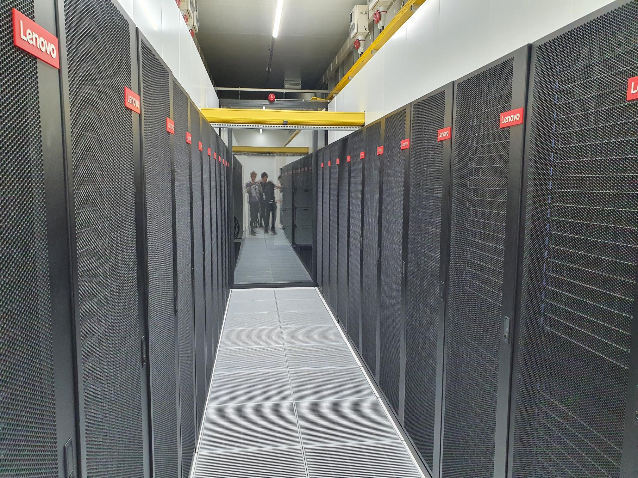

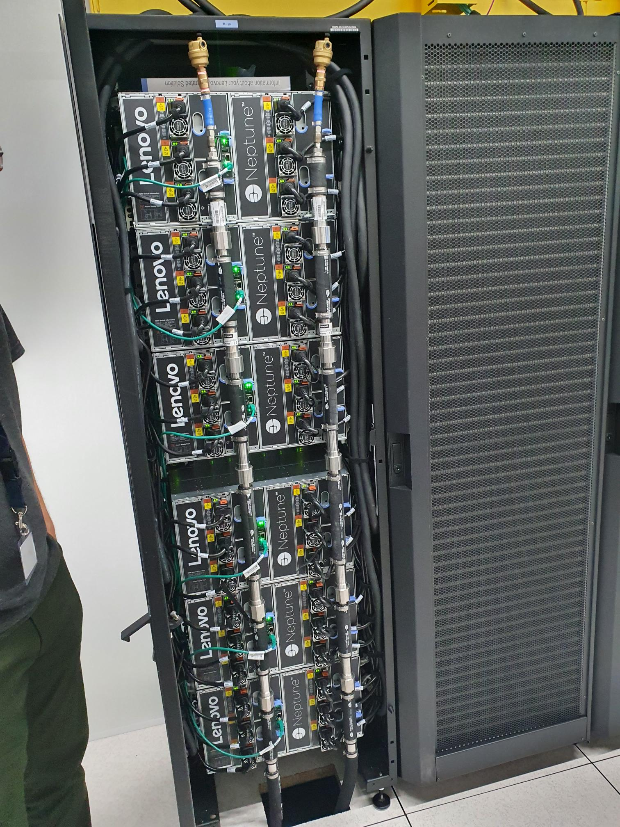
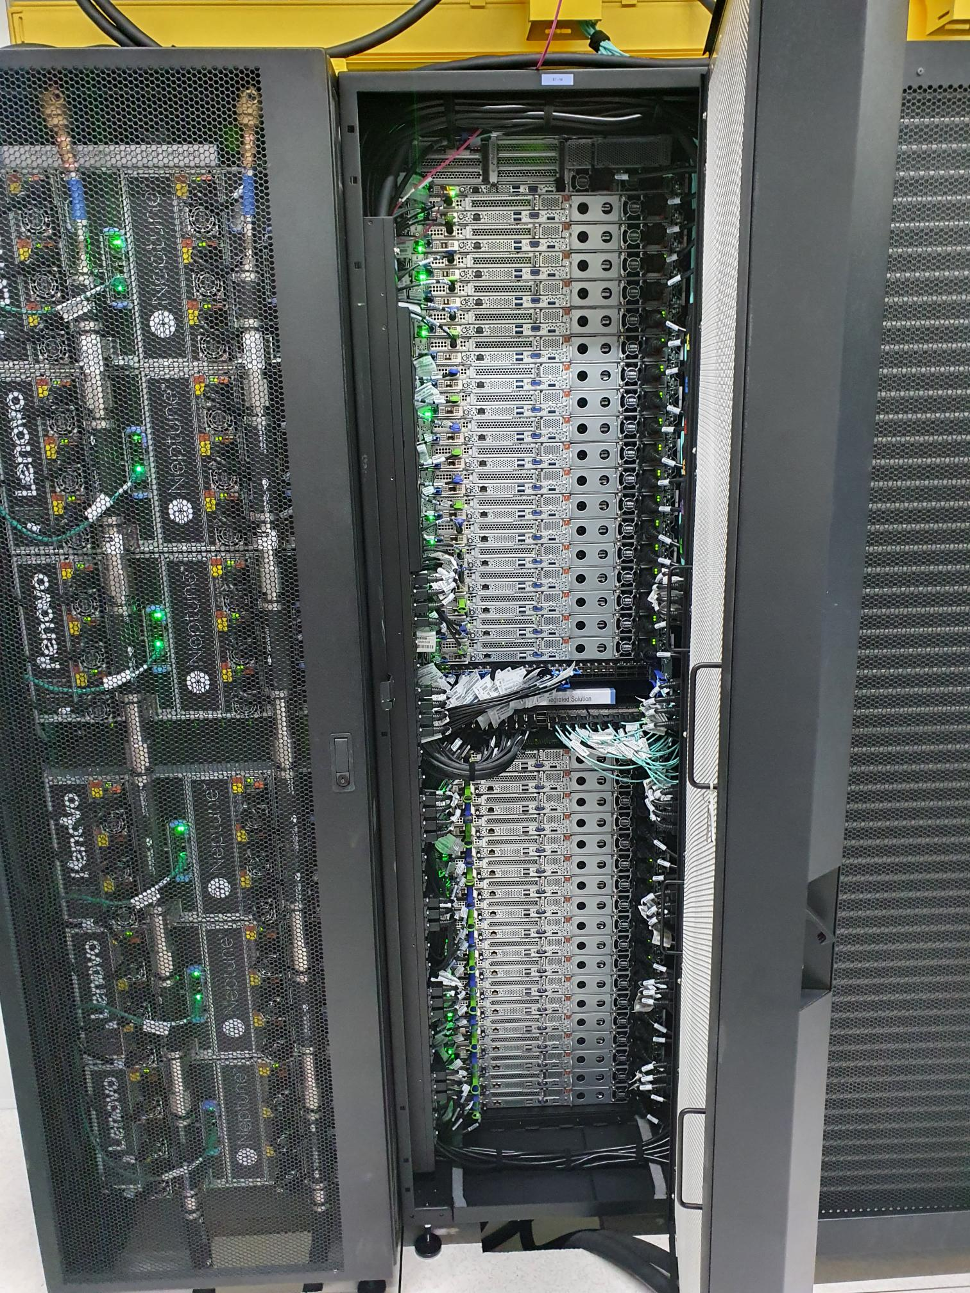

High-Performance Machine-Learning
Robert Jan Schlimbach
Team High-Performance Machine-Learning

Slide 2

In this presentation
Making (AI) workloads go fast
Warning: this will be messy
Material is available at https://github.com/SURF-ML/HPML-course-materials

Slide 3
In this presentation
Please:
Interrupt me if you have a question
Let me know if something is unclear (it’s probably me, not you)

Slide 4

Chapter orange
Macro

Slide 5


Who am I
Robert Jan:
UvA CS&AI grad
HPC ML advisor at SURF
Love making code go fast
Love running, climbing, and mountains
SURF
Help academia in a very broad sense
Eduroam, SurfConext, SurfMarket, National Supercomputer, etc...
Collaborate a lot in (Inter-)National projects
Bulwark against our Microsoft overlords
High-Performance Machine-Learning group
Very diverse set of people interested in everything AI & Science & HPC & …

Slide 6
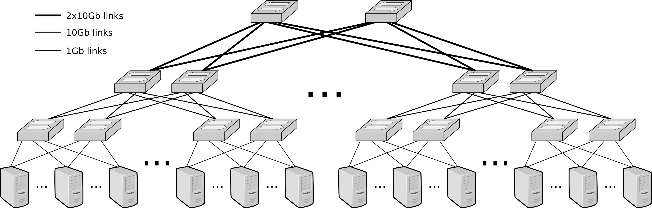
Snellius
~1300 CPU-based nodes
128-192 cores
256-378 GB RAM
~100 high-memory nodes
1TB-8TB RAM
160 GPU nodes
x4 nvidia A100s / H100s
512GB RAM
40GB /94 GB VRAM
Storage:
~13PB of medium-speed storage project space
720TB of home-dir
210TB of NVME
Interconnect: 100GBps Infiniband fat-tree

Slide 7
Access mechanisms
Direct access through institute
NWO small: <=1M SBUs, <= 10TB storage
NWO big: >1M SBUs, >10TB storage
LUMI access through SURF
LUMI/MN5/Leonardo/Jupiter: through EuroHPC
EuroCC: 50k SBUs for SMEs
We also offer Spider HTC (‘small compute & large data) and HPC Cloud (‘always on’) and dCache (data caching)
We offer consultancy!
4 hours ‘default’
Up to 160 hours ‘if we think your project is important’
NWO large: a lot

Slide 8






NCC
NCC Netherlands
NCC
NCC
NCC
The NCC Netherlands is a main point of contact at national level for expertise on HPC and HPDA, with a support network of more than 30 other countries in Europe. The main services are:
Training courses for researchers, SMEs and public institutions
Access to HPC facilities in the Netherlands
Proofs-of-concept on national HPC facilities for SMEs (8 consultancy hours and 50,000 core hours)
NCC
NCC
NCC
NCC
NCC
NCC
NCC
NCC
NCC
NCC
NCC
NCC
NCC
NCC
NCC
NCC
NCC
NCC
NCC
NCC
NCC
NCC
NCC
NCC
NCC
NCC
NCC
NCC
NCC

Slide 9



















Dutch HPC ecosystem
LUMI and Alice Recoque EuroHPC systems
EuroCC and Tier 0 support
SURF is coordinating the Dutch National Competence Centre and is part of the EuroCC initiative. SURF advisors actively participate in the LUMI User Support Team (LUST), providing specialised support in installing the software required for your research, running your applications and making efficient use of the resources that LUMI offers.
.
Dutch research can benefit from dedicated access to EuroHPC Tier 0 systems through dedicated national calls, as a result of the NL participation in consortia for LUMI and Alice Recoque systems.
Tier 0
National Supercomputer
Specialised services and support
Snellius is the Dutch National supercomputer, operated by SURF. Installed in September 2021 by Lenovo, the system has been expanded with more compute nodes and storage along the years. The last expansion was put in production in 2024 and added H100 GPU nodes.
We provide specialised services and support for our HPC system users, beyond basic system access and usage. We offer support on application porting, development and performance optimisation. We also support energy consumption analysis for greener, more cost-effective computations. Additional services include user-friendly UI (OpenOnDemand), secure computing environments for sensitive data handling (OSSC), and access to cutting-edge experimental hardware for innovative research (ETP).
Tier 1
Regional and University HPC systems
Local support and federated infrastructure
The Netherlands has a wide network of regional and university systems, managed by local HPC support teams. These systems bridge the gap to Tier 1 facilities, enabling efficient experimentation and development.
Tier 2 / Tier 3
Support teams at the different T2/T3 sites offer assistance for their users and we have extensive network to promote federated support across all sites and an integrate e-infrastructure and access mechanism (e.g. AAI, Tiered data storage, distributed software stack).
Notes:
We are covering the easy migration of applications and data from tier-2 facilities to Snellius (and back). This is a important problem for each tier-2 institute that will be at this meeting. Last year, we had this same event where we presented 5 related subtopics and one of them was the Federated Access (issues involving federated authorization and authentication in the context of multi-tier computing in the Netherlands). We had a presentation from Raymond who gave an overview of the possibilities and we discussed things at a very high level.

Slide 10
Chapter orange
Micro: fast(er) code

Slide 11
The three S'
Know your System
What kind of hardware do I have?
What features does my hardware support?
Know your Software
Does my software do what I want to do efficiently?
Does my software support my hardware features?
Know your Stack
What version of software am I running?
Is my stack compiled for my hardware?

Slide 12
System
Which CPUs?
Architectures: X86_64, ARM64
What kind of storage?
SSD, HDD, Tape?
SATA, NVMe or full PCI-E, Network?
What kind of Networking?
Ethernet? InfiniBand (IB)?
IOPs vs Throughput
What kind of RAM?
High Bandwidth Memory (HBM) or Double Data Rate (DDR)?
How much? Enough for a RAMdisk? (/dev/shm)
You (AI person) are always memory limited
Which GPUs?
AMD? Good raw performance, PyTorch support is improving
NVIDIA? Optimized for AI with good PyTorch support.
Intel? Technically supported in PyTorch.
https://servicedesk.surf.nl/wiki/display/WIKI/Snellius+hardware+and+file+systems

Slide 13
System
Goals:
Understand what hardware bottlenecks could be limiting
Understand pro’s and con’s of various hardware
Know how to choose appropriate hardware for you DL task
Know what to do to mitigate bottlenecks

Slide 14

Fundamental bottlenecks
E.g. training a compute intensive network on a single node
Compute (floating point operations per second, FLOPS)
Memory bandwidth
Memory size
I/O
Communication

Slide 15
Fundamental bottlenecks
Compute (floating point operations per second, FLOPS)
Memory bandwidth
Memory size
I/O
Communication
Data needs to get to the processor in time in order to do compute!
Many codes are limited by memory bandwidth

Slide 16
Fundamental bottlenecks
Compute (floating point operations per second, FLOPS)
Memory bandwidth
Memory size
I/O
Communication
(may be) limited by memory:
Deep/wide networks
Networks with very large input/output layers (e.g. high res images)
Not a performance bottleneck, but a no-go!
But: unified memory

Slide 17
Fundamental bottlenecks
Compute (floating point operations per second, FLOPS)
Memory bandwidth
Memory size
I/O
Communication
HPC systems typically have shared file systems
Good bandwitdh
(relatively) low I/O operations per second (IOPS)
Common bottleneck in distributed learning! Many nodes reading from the same filesystem.
Other users (& sysadmins) will dislike you if you do I/O in a naive way!

Slide 18
Fundamental bottlenecks
Compute (floating point operations per second, FLOPS)
Memory bandwidth
Memory size
I/O
Communication
Communication can be limiting in several ways:
Latency (many, small message send between nodes)
Bandwidth (few, large messages send between nodes)
Load imbalance (some workers in distributed job are slower / have more work; others have to wait when synchronization is needed)
CPU <-> GPU sync

Slide 19
Some context
What? | Time | Equivalent to N CPU instructions
CPU instruction | 0.25 ns (@4GHz) | 1
GPU instruction | 1 ns (@1 GHz) | 4
Fetch from L1 CPU cache | 0.5 ns | 2
Fetch from L2 CPU cache | 7 ns | 28
Fetch from main CPU memory | 100 ns | 400
CPU => GPU latency (PCI) | 300 ns | 1200
GPU ⬄ GPU latency (NVLink) | 300 ns | 1200
Infiniband network latency | 1 μs | 4k
Ethernet network latency | 10-1000 μs | 40k-4M
Seek time (NVMe SSD) | 20 μs | 80k
Seek time (Sata SSD) | 200 μs | 800k
Seek time (hard disk) | 2-5 ms | 8-20M
Network File System (NFS) response times | 10-40 ms | 40-120M
Robot Fetch time (Tape) | +- 60 s | 180B

Slide 20
Chapter orange
Micro: compute

Slide 21
Hardware overview
 | FP4 [TFLOPS] | FP8 [TFLOPS] | INT8 [TOPS] | FP16/BF16 [TFLOPS] | FP32 [TFLOPS] | FP64 [TFLOPS] | Memory [GB] | Memory Bandwidth [GB/s] | PCIe [GB/s] | Power draw [W] | FP16 TFLOP per Watt
AMD MI250 |  |  | 362.1 | 362.1 | 90.5 | 90.5 | 128 | 3276.8 | 31.51 | 560 | 0.64
AMD MI325x |  | 2615 | 2615 | 1307 | 654 | 163 | 256 | 6000 | 128 | 1000 | 1.3
NVIDIA A100 |  |  | 624 | 312 | 156 | 19.5 | 40/80 | 1555-2039 | 64 | 400 | 0.78
NVIDIA H100 |  | 1979 | 1979 | 990 | 495 | 67 | 80/96 | 2000-3900 | 128 | 700 | 1.32
NVIDIA GB200 | 20,000 | 10,000 | 10,000 | 5,000 | 2,500 | 90 | 384 | 16,000 | 256 | 2700 | 1.85
NVIDIA L40S (inference only) |  | 733 | 733 | 362 | 183 | 1.4 | 48 | 864 | 64 | 350 | 1.03
NVIDIA RTX 5090 (consumer) | 1676 | 838 | 838 | 420 | 105 | 1.6 | 24 | 1790 | 128 | 575 | 0.73
Intel Xeon Scalable 8180 (per socket) |  |  | - | - | 4.2 | 2.1 | 768 (max) | 119 (max) | 15.75 | 205 | 0.02
AMD EPYC 7601 (per socket) |  |  | - | - | 1.4 | 0.69 | 2000 (max) | 159 (max) | 15.75 | 180 | 0.008
Notes:
Add H100, add watt en perf per watt, add a10 inference

Slide 22
Hardware overview
GPUs support reduced precision, which has higher performance
 | FP4 [TFLOPS] | FP8 [TFLOPS] | INT8 [TOPS] | FP16/BF16 [TFLOPS] | FP32 [TFLOPS] | FP64 [TFLOPS] | Memory [GB] | Memory Bandwidth [GB/s] | PCIe [GB/s] | Power draw [W] | FP16 TFLOP per Watt
AMD MI250 |  |  | 362.1 | 362.1 | 90.5 | 90.5 | 128 | 3276.8 | 31.51 | 560 | 0.64
AMD MI325x |  | 2615 | 2615 | 1307 | 654 | 163 | 256 | 6000 | 128 | 1000 | 1.3
NVIDIA A100 |  |  | 624 | 312 | 156 | 19.5 | 40/80 | 1555-2039 | 64 | 400 | 0.78
NVIDIA H100 |  | 1979 | 1979 | 990 | 495 | 67 | 80/96 | 2000-3900 | 128 | 700 | 1.32
NVIDIA GB200 | 20,000 | 10,000 | 10,000 | 5,000 | 2,500 | 90 | 384 | 16,000 | 256 | 2700 | 1.85
NVIDIA L40S (inference only) |  | 733 | 733 | 362 | 183 | 1.4 | 48 | 864 | 64 | 350 | 1.03
NVIDIA RTX 5090 (consumer) | 1676 | 838 | 838 | 420 | 105 | 1.6 | 24 | 1790 | 128 | 575 | 0.73
Intel Xeon Scalable 8180 (per socket) |  |  | - | - | 4.2 | 2.1 | 768 (max) | 119 (max) | 15.75 | 205 | 0.02
AMD EPYC 7601 (per socket) |  |  | - | - | 1.4 | 0.69 | 2000 (max) | 159 (max) | 15.75 | 180 | 0.008
Prace best practice guide – deep learning
https://en.wikipedia.org/wiki/Ampere_(microarchitecture)
Notes:
Add H100, add watt en perf per watt, add a10 inference

Slide 23
Hardware overview
GPUs have a lot of FLOPS
compared to CPUs
 | FP4 [TFLOPS] | FP8 [TFLOPS] | INT8 [TOPS] | FP16/BF16 [TFLOPS] | FP32 [TFLOPS] | FP64 [TFLOPS] | Memory [GB] | Memory Bandwidth [GB/s] | PCIe [GB/s] | Power draw [W] | FP16 TFLOP per Watt
AMD MI250 |  |  | 362.1 | 362.1 | 90.5 | 90.5 | 128 | 3276.8 | 31.51 | 560 | 0.64
AMD MI325x |  | 2615 | 2615 | 1307 | 654 | 163 | 256 | 6000 | 128 | 1000 | 1.3
NVIDIA A100 |  |  | 624 | 312 | 156 | 19.5 | 40/80 | 1555-2039 | 64 | 400 | 0.78
NVIDIA H100 |  | 1979 | 1979 | 990 | 495 | 67 | 80/96 | 2000-3900 | 128 | 700 | 1.32
NVIDIA GB200 | 20,000 | 10,000 | 10,000 | 5,000 | 2,500 | 90 | 384 | 16,000 | 256 | 2700 | 1.85
NVIDIA L40S (inference only) |  | 733 | 733 | 362 | 183 | 1.4 | 48 | 864 | 64 | 350 | 1.03
NVIDIA RTX 5090 (consumer) | 1676 | 838 | 838 | 420 | 105 | 1.6 | 24 | 1790 | 128 | 575 | 0.73
Intel Xeon Scalable 8180 (per socket) |  |  | - | - | 4.2 | 2.1 | 768 (max) | 119 (max) | 15.75 | 205 | 0.02
AMD EPYC 7601 (per socket) |  |  | - | - | 1.4 | 0.69 | 2000 (max) | 159 (max) | 15.75 | 180 | 0.008
Notes:
Add H100, add watt en perf per watt, add a10 inference

Slide 24
Hardware overview
CPUs have a lot of memory compared to GPUs
 | FP4 [TFLOPS] | FP8 [TFLOPS] | INT8 [TOPS] | FP16/BF16 [TFLOPS] | FP32 [TFLOPS] | FP64 [TFLOPS] | Memory [GB] | Memory Bandwidth [GB/s] | PCIe [GB/s] | Power draw [W] | FP16 TFLOP per Watt
AMD MI250 |  |  | 362.1 | 362.1 | 90.5 | 90.5 | 128 | 3276.8 | 31.51 | 560 | 0.64
AMD MI325x |  | 2615 | 2615 | 1307 | 654 | 163 | 256 | 6000 | 128 | 1000 | 1.3
NVIDIA A100 |  |  | 624 | 312 | 156 | 19.5 | 40/80 | 1555-2039 | 64 | 400 | 0.78
NVIDIA H100 |  | 1979 | 1979 | 990 | 495 | 67 | 80/96 | 2000-3900 | 128 | 700 | 1.32
NVIDIA GB200 | 20,000 | 10,000 | 10,000 | 5,000 | 2,500 | 90 | 384 | 16,000 | 256 | 2700 | 1.85
NVIDIA L40S (inference only) |  | 733 | 733 | 362 | 183 | 1.4 | 48 | 864 | 64 | 350 | 1.03
NVIDIA RTX 5090 (consumer) | 1676 | 838 | 838 | 420 | 105 | 1.6 | 24 | 1790 | 128 | 575 | 0.73
Intel Xeon Scalable 8180 (per socket) |  |  | - | - | 4.2 | 2.1 | 768 (max) | 119 (max) | 15.75 | 205 | 0.02
AMD EPYC 7601 (per socket) |  |  | - | - | 1.4 | 0.69 | 2000 (max) | 159 (max) | 15.75 | 180 | 0.008
Notes:
Add H100, add watt en perf per watt, add a10 inference

Slide 25
Hardware overview
Memory bandwidth relative to FLOPS is approximately the same
 | FP4 [TFLOPS] | FP8 [TFLOPS] | INT8 [TOPS] | FP16/BF16 [TFLOPS] | FP32 [TFLOPS] | FP64 [TFLOPS] | Memory [GB] | Memory Bandwidth [GB/s] | PCIe [GB/s] | Power draw [W] | FP16 TFLOP per Watt
AMD MI250 |  |  | 362.1 | 362.1 | 90.5 | 90.5 | 128 | 3276.8 | 31.51 | 560 | 0.64
AMD MI325x |  | 2615 | 2615 | 1307 | 654 | 163 | 256 | 6000 | 128 | 1000 | 1.3
NVIDIA A100 |  |  | 624 | 312 | 156 | 19.5 | 40/80 | 1555-2039 | 64 | 400 | 0.78
NVIDIA H100 |  | 1979 | 1979 | 990 | 495 | 67 | 80/96 | 2000-3900 | 128 | 700 | 1.32
NVIDIA GB200 | 20,000 | 10,000 | 10,000 | 5,000 | 2,500 | 90 | 384 | 16,000 | 256 | 2700 | 1.85
NVIDIA L40S (inference only) |  | 733 | 733 | 362 | 183 | 1.4 | 48 | 864 | 64 | 350 | 1.03
NVIDIA RTX 5090 (consumer) | 1676 | 838 | 838 | 420 | 105 | 1.6 | 24 | 1790 | 128 | 575 | 0.73
Intel Xeon Scalable 8180 (per socket) |  |  | - | - | 4.2 | 2.1 | 768 (max) | 119 (max) | 15.75 | 205 | 0.02
AMD EPYC 7601 (per socket) |  |  | - | - | 1.4 | 0.69 | 2000 (max) | 159 (max) | 15.75 | 180 | 0.008
Notes:
Add H100, add watt en perf per watt, add a10 inference

Slide 26
Hardware overview
GPU price is often irrelevant, but the performance per Watt is.
 | FP4 [TFLOPS] | FP8 [TFLOPS] | INT8 [TOPS] | FP16/BF16 [TFLOPS] | FP32 [TFLOPS] | FP64 [TFLOPS] | Memory [GB] | Memory Bandwidth [GB/s] | PCIe [GB/s] | Power draw [W] | FP16 TFLOP per Watt
AMD MI250 |  |  | 362.1 | 362.1 | 90.5 | 90.5 | 128 | 3276.8 | 31.51 | 560 | 0.64
AMD MI325x |  | 2615 | 2615 | 1307 | 654 | 163 | 256 | 6000 | 128 | 1000 | 1.3
NVIDIA A100 |  |  | 624 | 312 | 156 | 19.5 | 40/80 | 1555-2039 | 64 | 400 | 0.78
NVIDIA H100 |  | 1979 | 1979 | 990 | 495 | 67 | 80/96 | 2000-3900 | 128 | 700 | 1.32
NVIDIA GB200 | 20,000 | 10,000 | 10,000 | 5,000 | 2,500 | 90 | 384 | 16,000 | 256 | 2700 | 1.85
NVIDIA L40S (inference only) |  | 733 | 733 | 362 | 183 | 1.4 | 48 | 864 | 64 | 350 | 1.03
NVIDIA RTX 5090 (consumer) | 1676 | 838 | 838 | 420 | 105 | 1.6 | 24 | 1790 | 128 | 575 | 0.73
Intel Xeon Scalable 8180 (per socket) |  |  | - | - | 4.2 | 2.1 | 768 (max) | 119 (max) | 15.75 | 205 | 0.02
AMD EPYC 7601 (per socket) |  |  | - | - | 1.4 | 0.69 | 2000 (max) | 159 (max) | 15.75 | 180 | 0.008
Notes:
Add H100, add watt en perf per watt, add a10 inference

Slide 27
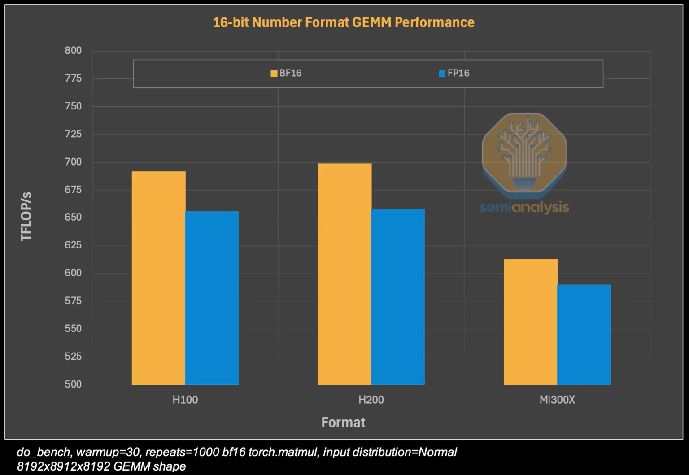
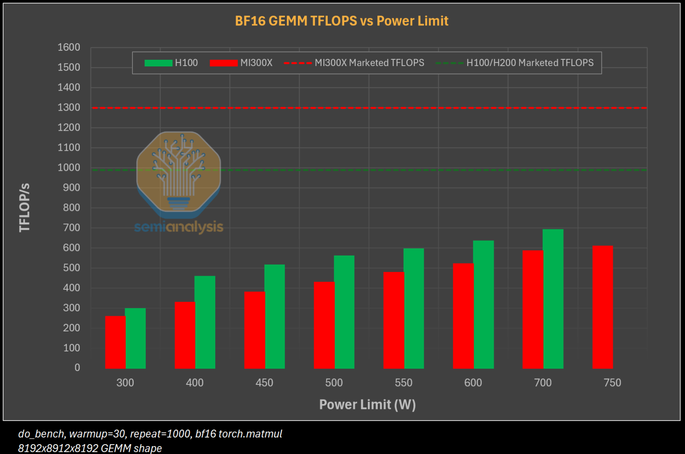
Performance in practice
In practice, the performance can be different (depending on software)
GPUs: observed FLOPS is ~2/3 of theoretical FLOPS

Slide 28
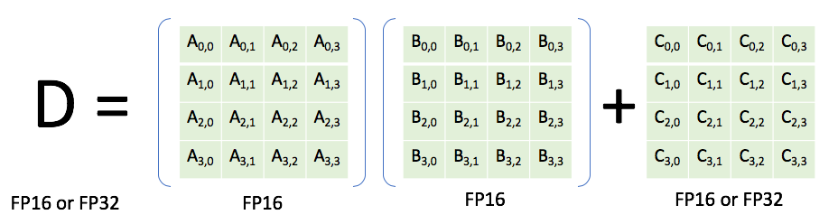
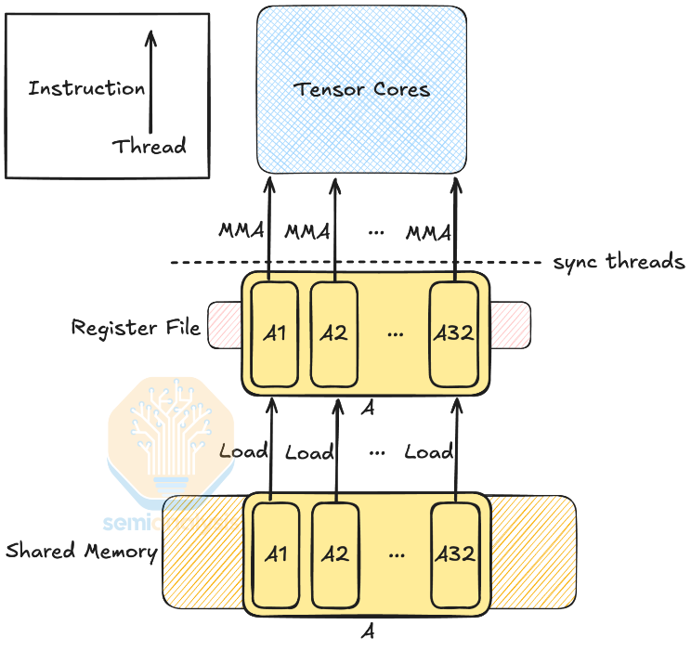
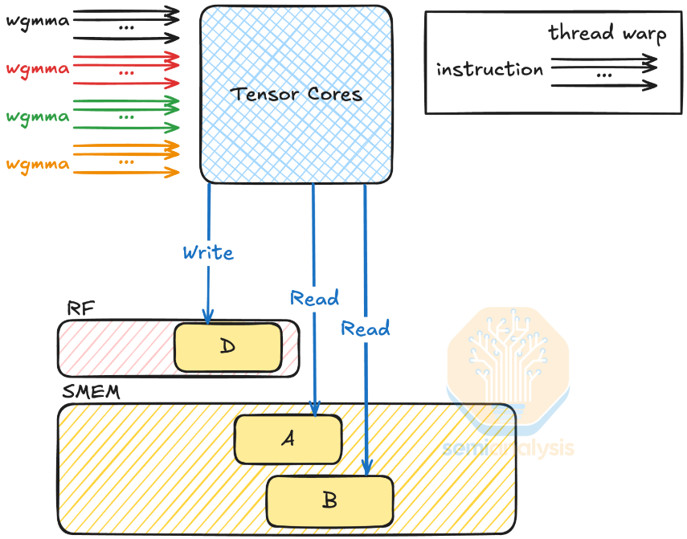
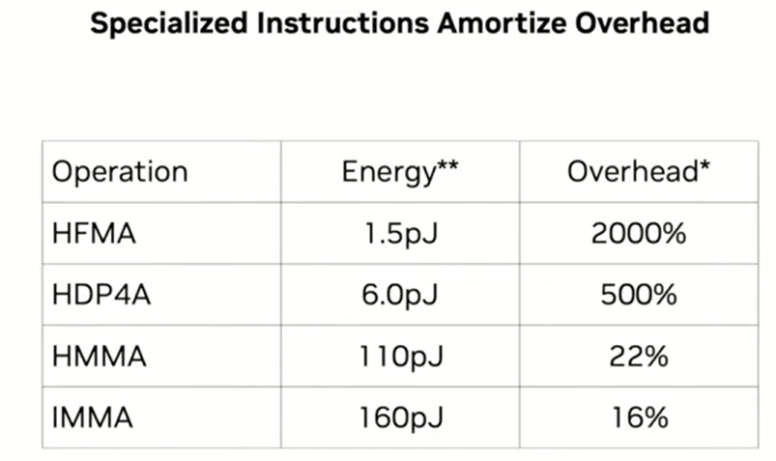
Tensor cores
Lower precision
Increasingly specialized
Pack as many instructions in one go to avoid instruction overhead, & avoid data movement
H=Half, I=Integer, FMA=Fused Multiply Add, DP=Dot Product, MMA = Matrix Multiplication Add
Previously: Now:

Slide 29
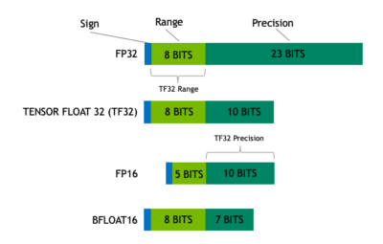
Lower precision for DL
Again: lower precision is a double-whammy of more efficient computation and loading less data
Generally, you are responsible for specifying a reduced precision: DL frameworks don’t do this automatically since it may impact your networks accuracy, convergence, etc
Mixed precision uses FP16. Reduced range causes (potential) need for gradient scaling to prevent underflows

Slide 30
Lower precision for DL
Again: lower precision is a double-whammy of more efficient computation and loading less data
Generally, you are responsible for specifying a reduced precision: DL frameworks don’t do this automatically since it may impact your networks accuracy, convergence, etc
TF32 tries to combine best of both worlds: range of an FP32 (no gradient scaling needed), but with reduced precision (for speedup & less memory)

Slide 31
Lower precision for DL
Again: lower precision is a double-whammy of more efficient computation and loading less data
Generally, you are responsible for specifying a reduced precision: DL frameworks don’t do this automatically since it may impact your networks accuracy, convergence, etc
Automatically used unless
Environment variable NVIDIA_TF32_OVERRIDE=0 is set
torch.backends.cuda.matmul.allow_tf32 = False and torch.backends.cudnn.allow_tf32 = False are set

Slide 32
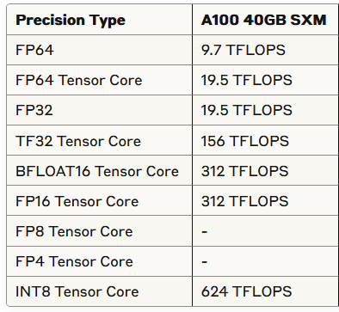
Lower precision for DL
Source: https://servicedesk.surf.nl/wiki/display/WIKI/Deep+Learning+on+A100+GPUs

Slide 33
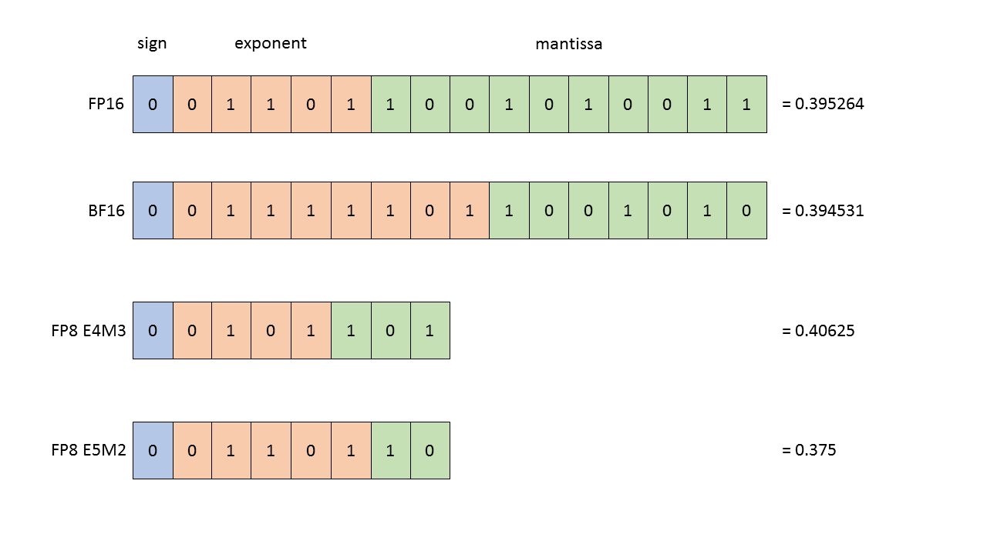
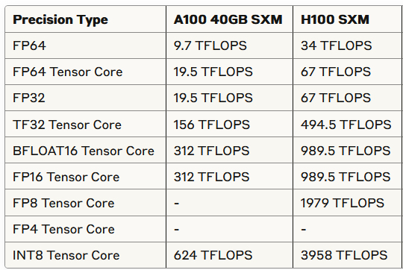
Nvidia Hopper (e.g. H100)
FP8 support
Transformer Engine for transformer specific improvements

Slide 34
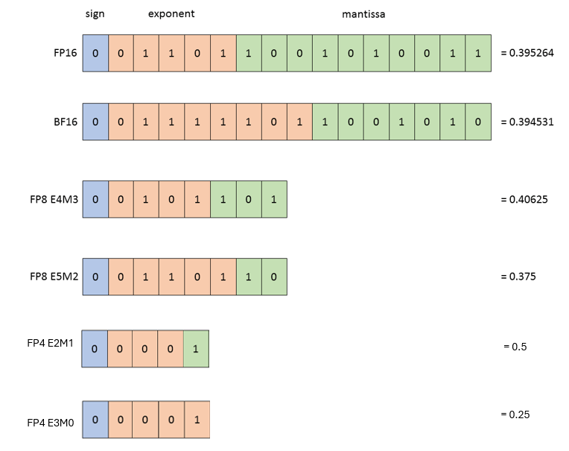
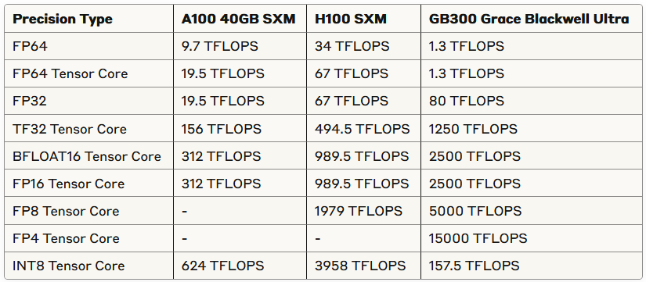
Nvidia Blackwell GPUs (e.g. B300)
FP4 support
Second-generation Transformer Engine

Slide 35
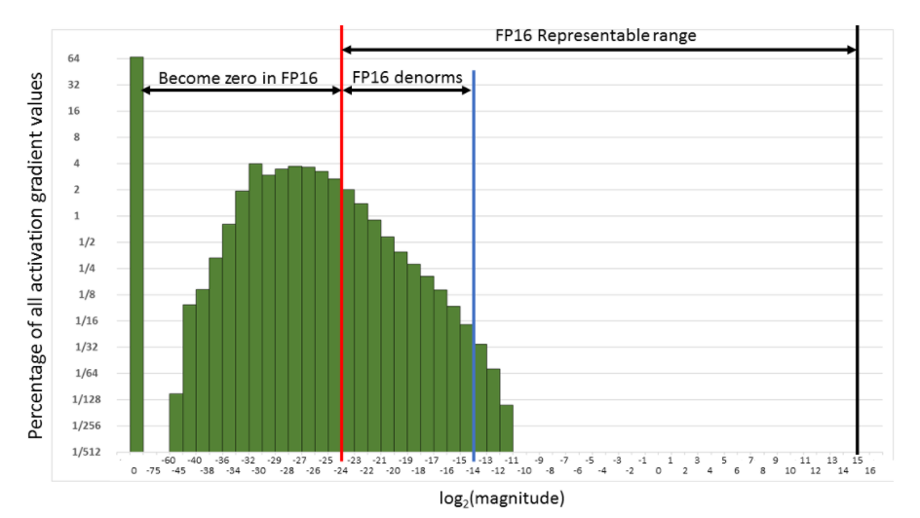
Thinking about the distribution of your data & model becomes even more important

Slide 36
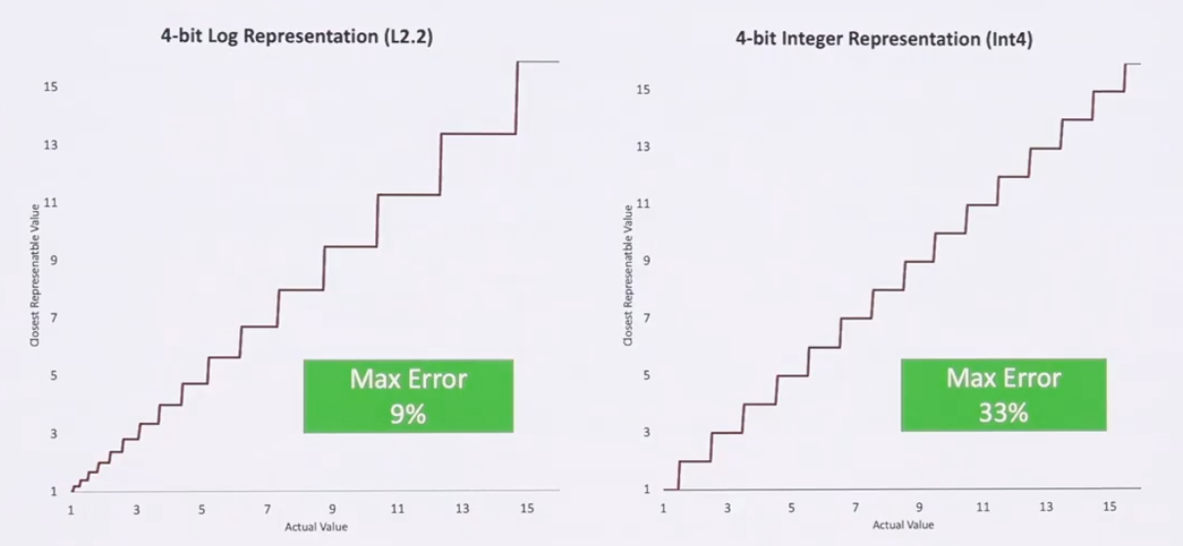
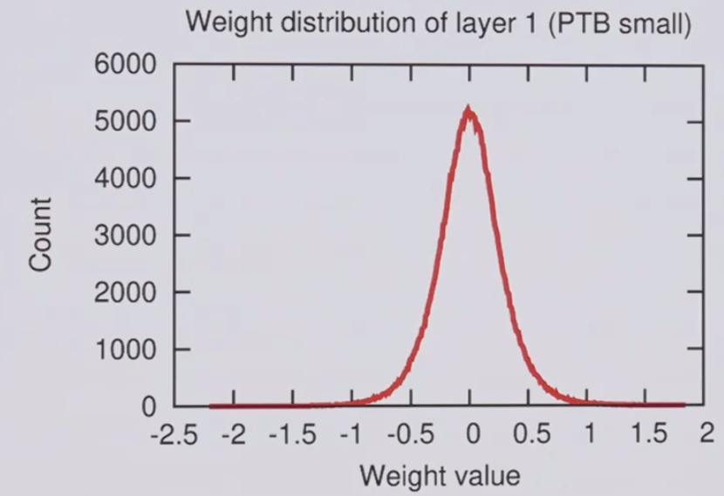
Thinking about the distribution of your data & model becomes even more important

Slide 37
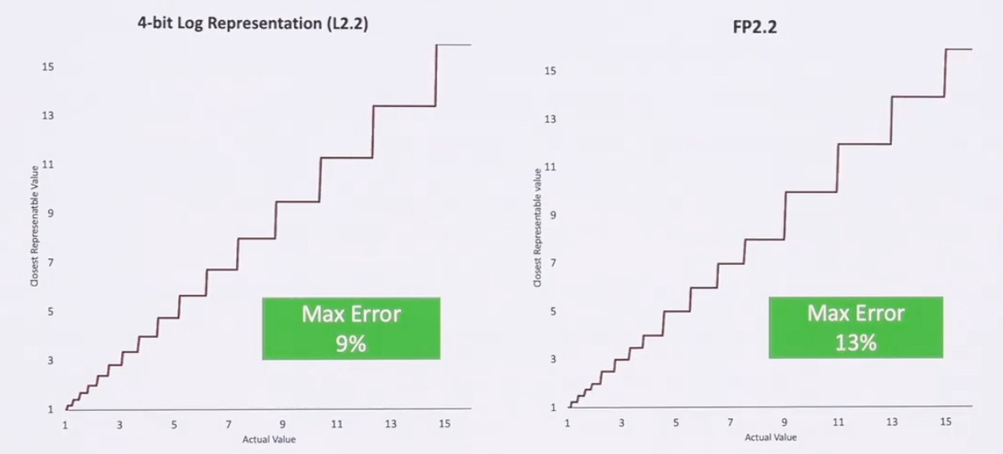
Thinking about the distribution of your data & model becomes even more important

Slide 38
Chapter orange
Micro: storage

Slide 39
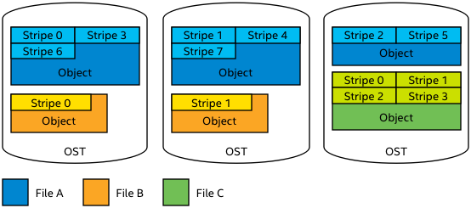
HPC File System
HPC systems typically use parallel shared file systems.
Parallel file system: one file can be distributed over many physical disks, to increase I/O bandwidth.

Slide 40
HPC File System
Two main types of parallel filesystems
Lustre
Metadata (filename, size, location, etc) stored on separate server
Object Storage Target (OST) stores actual file
Striping over multiple OSTs can be managed by user
GPFS (Snellius)
Metadata and actual file stored on the same server
Striping is managed automatically, by file system. User has no control.

Slide 41
HPC File System
HPC file systems are optimized for bandwidth not I/O operations per second (IOPS)
E.g. Snellius GPFS: up to 10 GB/s write, 20 GB/s read
Important when e.g. a 100 node job needs to start from the same 20 GB input file…
HPC file systems are typically not good at AI / data science workloads
AI workloads are generally: reading lots of small files / parts of a file

Slide 42
HPC File System
An inode stores all information about a linux file except its name and data
File size, last change date, file permissions, etc
On most HPC systems, you’ll have an inode quota, in addition to a size quota
Like total size, each filesystem has a (fixed) maximum number of inodes
It is also a way to discourage doing to many IOPS

Slide 43
HPC File System
An inode stores all information about a linux file except its name and data
File size, last change date, file permissions, etc
On most HPC systems, you’ll have an inode quota, in addition to a size quota
Like total size, each filesystem has a (fixed) maximum number of inodes
It is also a way to discourage doing to many IOPS
Seems we’ll run out of inodes before we run out of space on e.g. our home1 filesystem:
$ df -ih /gpfs/home1/
Filesystem Inodes IUsed IFree IUse% Mounted on
home1 287M 141M 146M 50% /gpfs/home1
$ df -h /gpfs/home1/
Filesystem Size Used Avail Use% Mounted on
home1 121T 56T 66T 46% /gpfs/home1

Slide 44
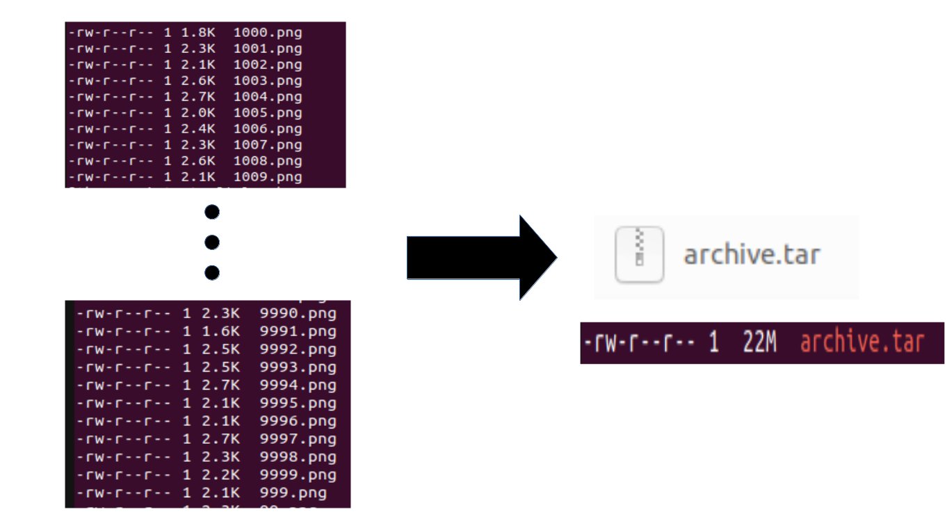
HPC File System
Suppose your dataset is 10k png files of 2k each…
Home1: 121TB, 287M inodes, so 421k per inode
If everyone does this, the filesystem will be full of inodes, with 99.5% / 120 TB (!) storage still available…

Slide 45
HPC File System
Suppose your dataset is 10k png files of 2k each…
Home1: 121TB, 287M inodes, so 421k per inode
If everyone does this, the filesystem will be full of inodes, with 99.5% / 120 TB (!) storage still available…
If you run 100 epochs, you’ll do 1M I/O operations
Your sysadmin won’t like you
Your fellow users won’t like you: everyone suffers slow I/O because of your job!
You shouldn’t like you: your I/O might be holding back your training performance…

Slide 46
Packed Data Format
What is a ‘packed data format’?
Group multiple individual files together in a single ‘packed’/archive file

Slide 47
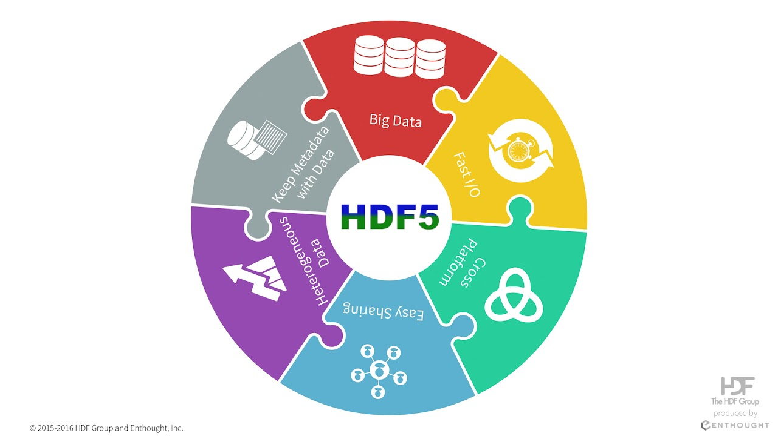
Packed Data Format
What is a ‘packed data format’?
Group multiple individual files together in a single ‘packed’/archive file
Examples of packed data formats → ZIP, TAR, LMDB, HDF5, PARQUET, etc.
Does not necessarily involve compression!
Compression is possible, but often runs on single process, so slow to decompress

Slide 48
Packed Data Format
What is a ‘packed data format’?
Group multiple individual files together in a single ‘packed’/archive file
Examples of packed data formats → ZIP, TAR, LMDB, HDF5, PARQUET, etc.
Does not necessarily involve compression!
Compression is possible, but often runs on single process, so slow to decompress
Why packed data format
HPC systems use a shared filesystem. Packed data formats…
Reduces inode consumption
Reduces number of I/O operations/s
Reduces slowdown for yourself and other users
https://servicedesk.surf.nl/wiki/spaces/WIKI/pages/56295498/Best+Practice+for+Data+Formats+in+Deep+Learning

Slide 49
Local Scratch Disks
Some HPC systems have local disks in the nodes
On Snellius, these can be requested by adding #SBATCH –constraint=scratch-node to your batch script
Note: about half our GPU nodes have local scratch disk. You might be in the queue longer if you request scratch-node, so only do it if you think you benefit from it

Slide 50
Local Scratch Disks
Some HPC systems have local disks in the nodes
On Snellius, these can be requested by adding #SBATCH –constraint=scratch-node to your batch script
Note: about half our GPU nodes have local scratch disk. You might be in the queue longer if you request scratch-node, so only do it if you think you benefit from it
Local scratch disks can usually handle much more IOPs
Local scratch disks are shared between all users in a node
Users on the same node may still experience some effects when you ‘hammer’ local scratch with I/O, but it’s way less bad than on a shared filesystem!

Slide 51
Local Scratch Disks
Some HPC systems have local disks in the nodes
If you really need to use individual files instead of a packed file format, use local scratch disks in the following way:
Store zip/tar on shared parallel Filesystem.
At start of job: extract to local scratch dir (for every node, if you use multiple)
Do any further I/O from that local scratch dir

Slide 52
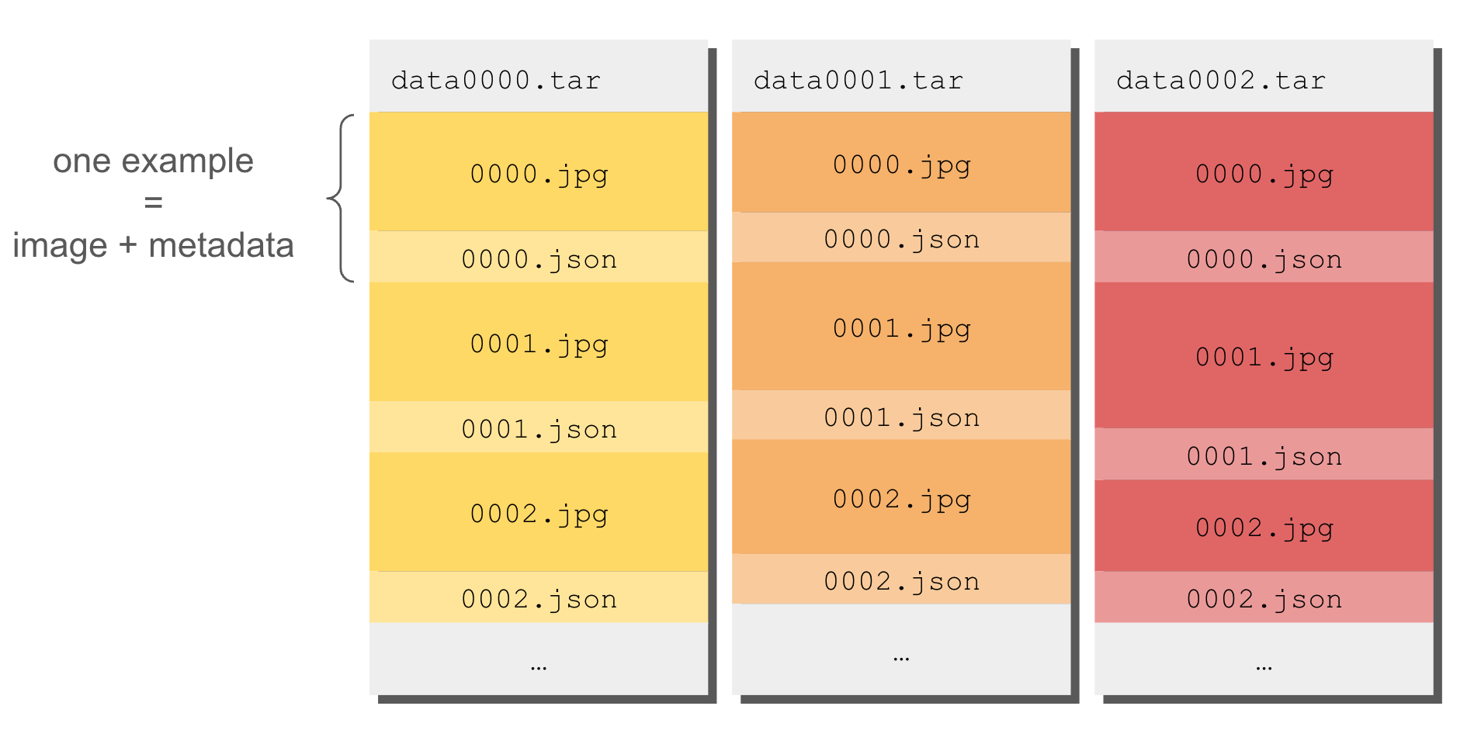
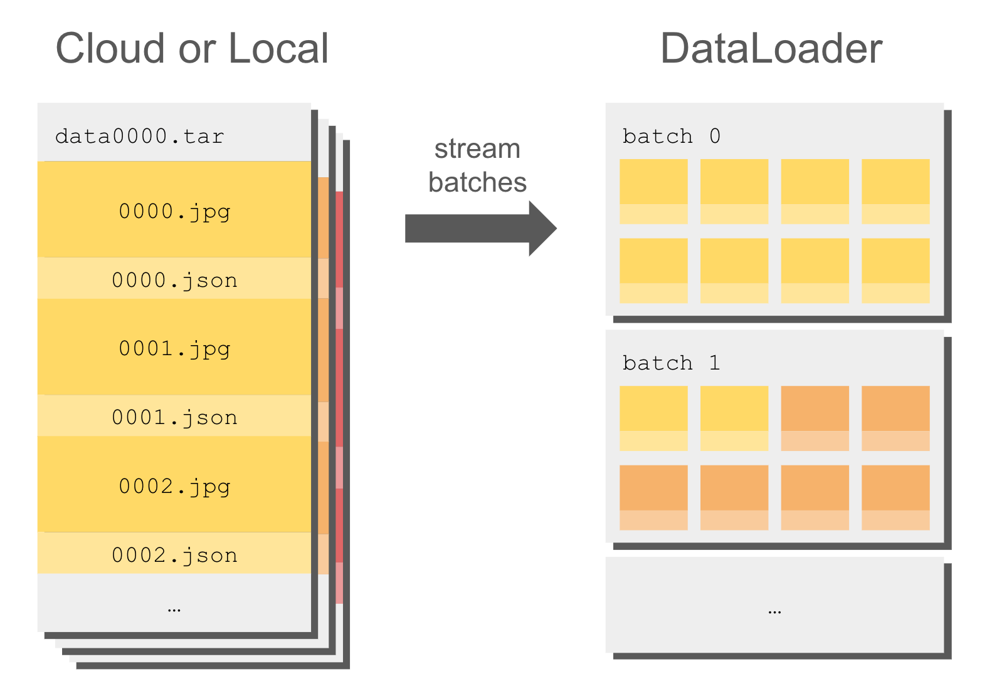
Practically
Use WebDataset
Use Huggingface datasets

Slide 53
Chapter orange
Micro: parallelism

Slide 54
Types of parallelization
What types of parallelization exist?
Instruction level parallelism
Embarrassingly parallel
Data parallel
Fully Sharded Data parallel
Model parallel:
Pipeline parallel
Tensor parallel
Sequence parallel
Hybrid data/model parallelism
Increasing complexity/bandwidth

Slide 55
Types of parallelization
Instruction level parallelism
Executing multiple instructions (e.g. additions) in parallel
Examples: vector instructions (CPU), Tensor Cores (GPU)
https://en.wikipedia.org/wiki/Instruction-level_parallelism
X =
1.1 | 3.7 | -1.6 | 2.3
+
=
-2.3 | 5.4 | -1.8 | 7.5
Y =
-3.4 | 1.7 | -0.2 | 5.2

Slide 56
Types of parallelization
Embarrassingly parallel
A workload or problem where little or no effort is needed to separate into number of parallel tasks
Examples: hyperparameter grid search, training multiple model architectures
https://en.wikipedia.org/wiki/Embarrassingly_parallel

Slide 57
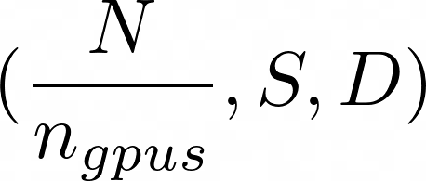






Data Parallelism
Train a single model, single set of hyperparameters, but faster
Split the batch over multiple processors (CPUs/GPUs)
Each processor holds a copy of the model
Forward pass: calculated by each of the workers
Backward pass: gradients computed (per worker), communicated and aggregated
Effective batch size is a multiple of the number of workers
In reality: keep the per-device batch-size the same, just scale the global batch-size and increase LR proportionally
Processor 1
Processor 2

Slide 58
Model parallelism
Train a single very big model, single set of hyperparameters
Split the model over multiple processors (CPUs/GPUs or a hybrid)
Each processor sees all the data
Communication needed both during forward and backward pass!
Processor 1
Processor 2

Slide 59
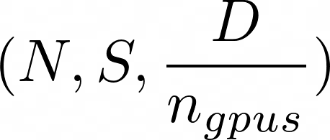
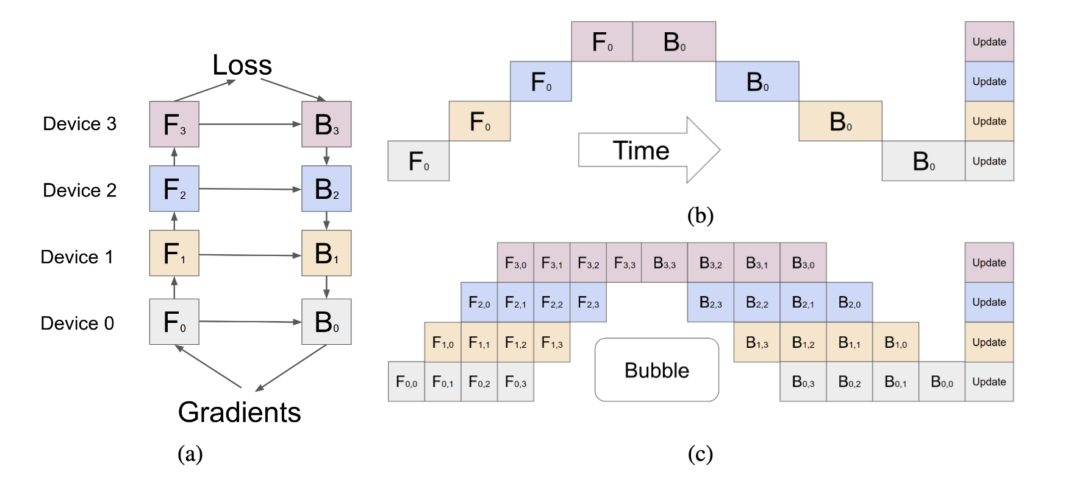
Model parallelism: Pipeline parallelism
Model parallelism, executed in a pipelined fashion over multiple micro-batches (data parallelism).
More efficient than model parallelism: hides communication with computation
See https://pytorch.org/docs/stable/distributed.pipelining.html
Huang et al. (2019, arXiv:1811.06965)

Slide 60
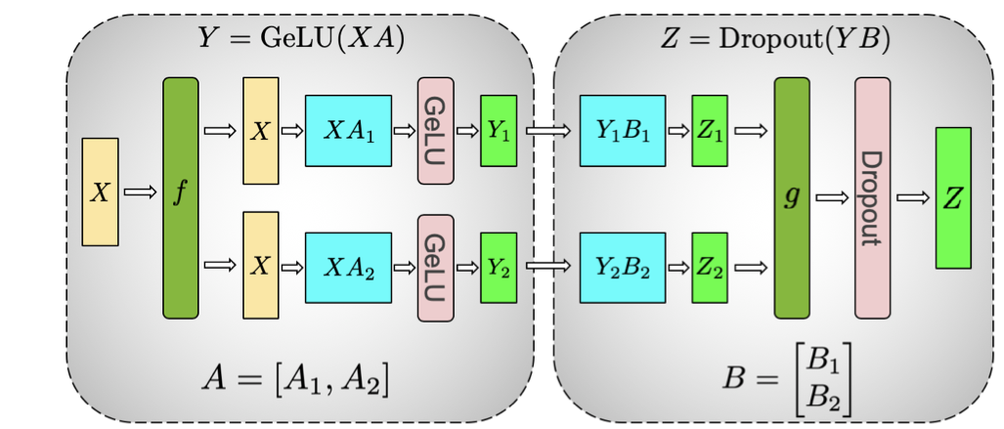
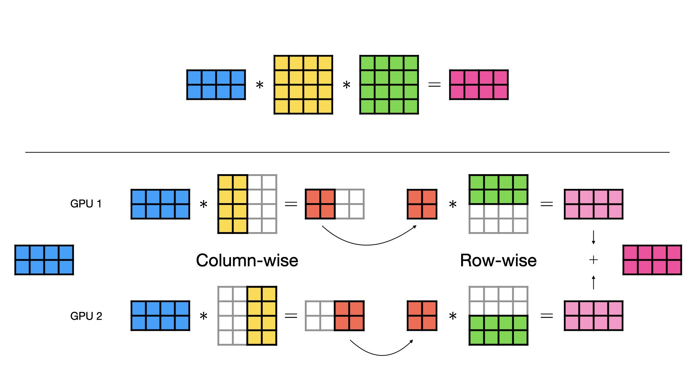

Model parallelism: Tensor parallelism
Split individual weight W and/or feature X tensors across devices:
$Y=ReLU\left(X W\right)$
$X=\left[X_{1}, X_{2}\right], W=\left[\begin{aligned}W_{1} \\ W_{2}\end{aligned}\right]$ -> $Y=ReLU(X_{1}W_{1}+X_{2}W_{2})$
Requires device sync due to non-linearity a synchronization is required, instead split $W=\left[W_{1}, W_{2}\right]$
$\left[Y_{1}, Y_{2}\right]=[ReLU\left(XW_{1}\right),ReLU\left(XW_{2}\right)]$
https://arxiv.org/pdf/1909.08053

Slide 61
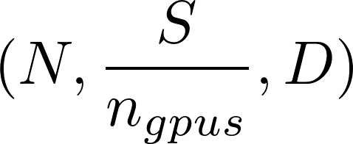
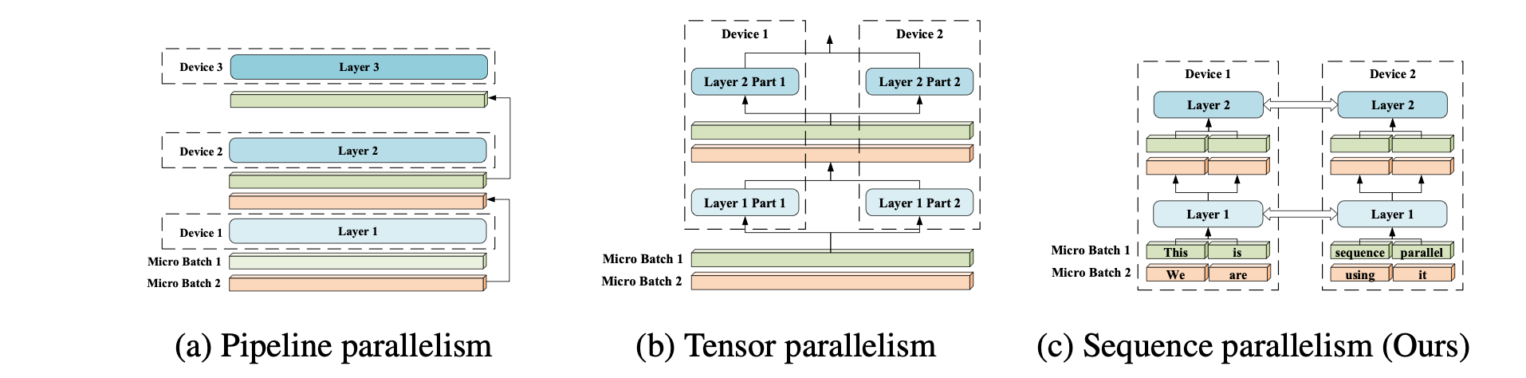
Model parallelism: Sequence parallel
Split longer sequences (e.g. sentences) across devices.
Higher maximum batch size and throughput compared to tensor parallel
Li, Shenggui, et al. arXiv preprint:2105.13120 (2021).

Slide 62
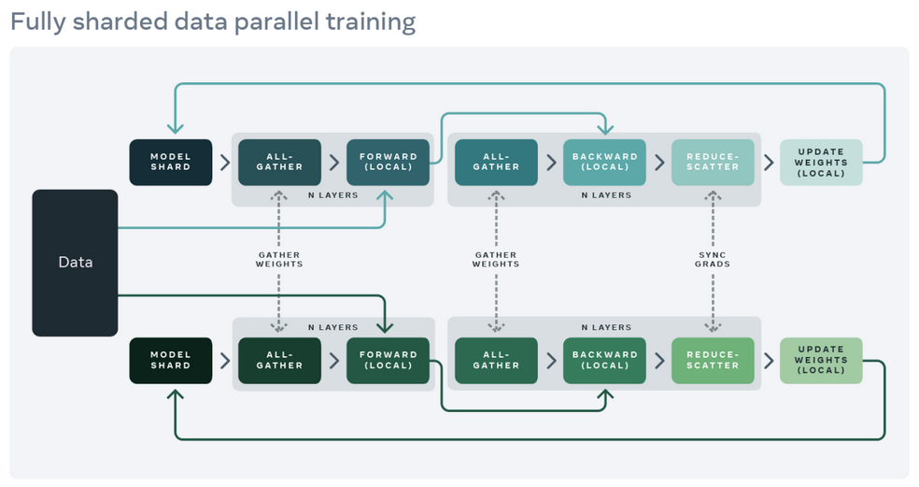
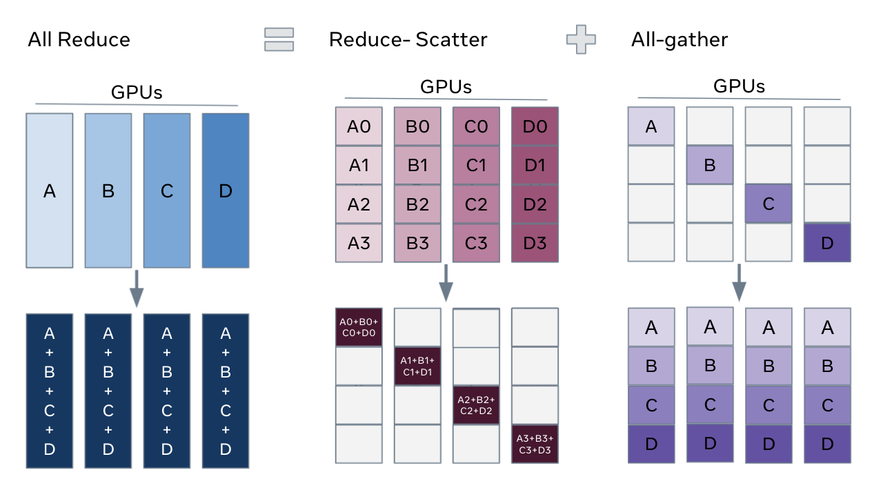
FSDP Workflow
AKA weird non-pipeline parallel, non-tensor parallel, tensor+pipeline parallel (actually just DP)
In constructor - Shard model parameters and each rank only keeps its own shard
In forward path - Run all_gather to collect all shards from all ranks to recover the full parameter in this FSDP unit - Run forward computation - Discard parameter shards it has just collected
In backward path - Run all_gather to collect all shards from all ranks to recover the full parameter in this FSDP unit - Run backward computation - Run reduce_scatter to sync gradients - Discard parameters.

Slide 63
Hybrid model/data parallelism
Processor 1
Processor 2
Processor 3
Processor 4

Slide 64
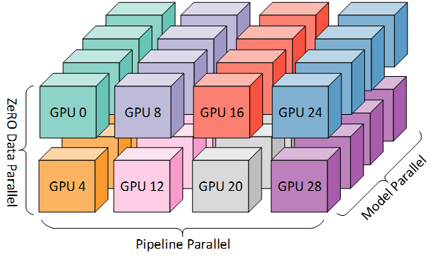
3D Parallelism
Combined Data Parallel, Pipeline Parallel, Tensor Parallel
4D: including Sequence parallel
3D grid of devices
Each dimension deals with its own parallelization type
Physical location of GPUs with respect to each other matters
For example:
Tensor parallel between GPUs in node
Pipeline parallel between nodes
Data parallel between racks

Slide 65
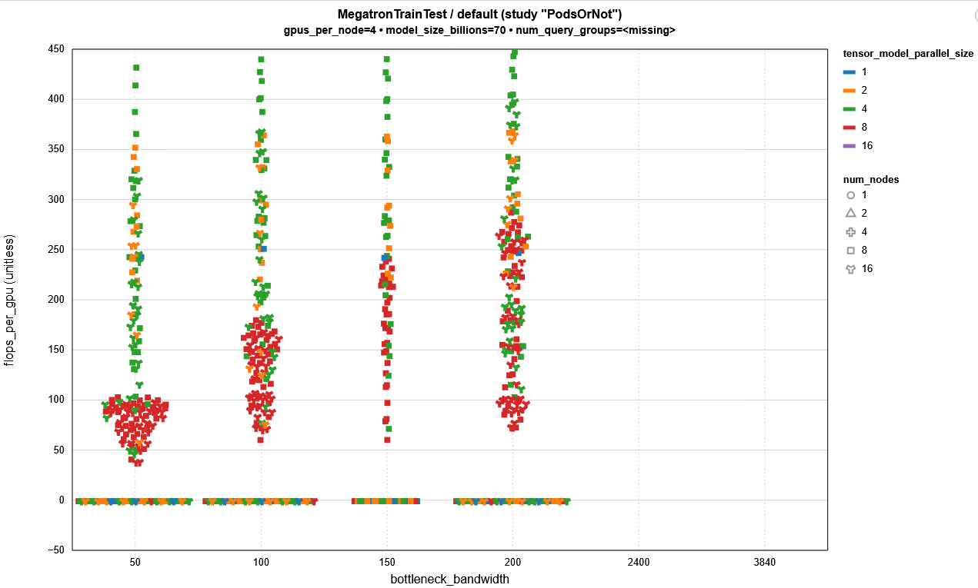

TP=4 (TP=tensor parallel) Not bottlenecked by network
TFLOPs per GPU.
TP=8 (so outside the node) clearly scaling with network bandwidth.
Lost performance fraction
~0.45, implying in a best case at least ~400Gbps needed per GPU to not be bottlenecked by Network, Probably more like ~600-800Gbps per GPU due to Amdahl’s law (not taking into account TP=8 may scale above TP=4)
- TP=4 better than TP=2, implying TP=8 may be better than TP=4 given enough bandwidth
Out of memory runs register as -1.
Different levels of GPU>GPU speed (in Gbps)

Slide 66
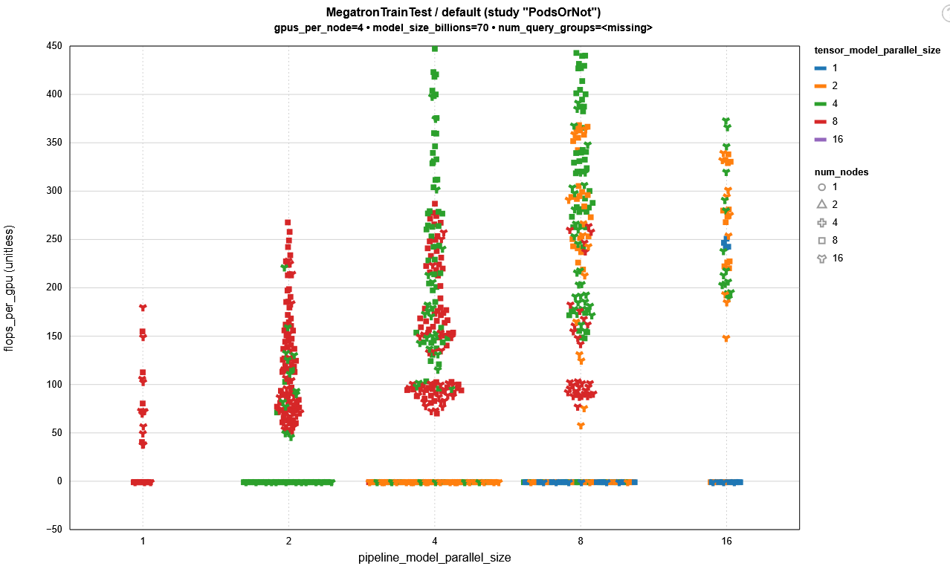
Flipping to PP (pipeline parallel) view:
TP=4 Still dominates performant codes
Again implying that TP=8 may be better given enough bandwidth

Slide 67
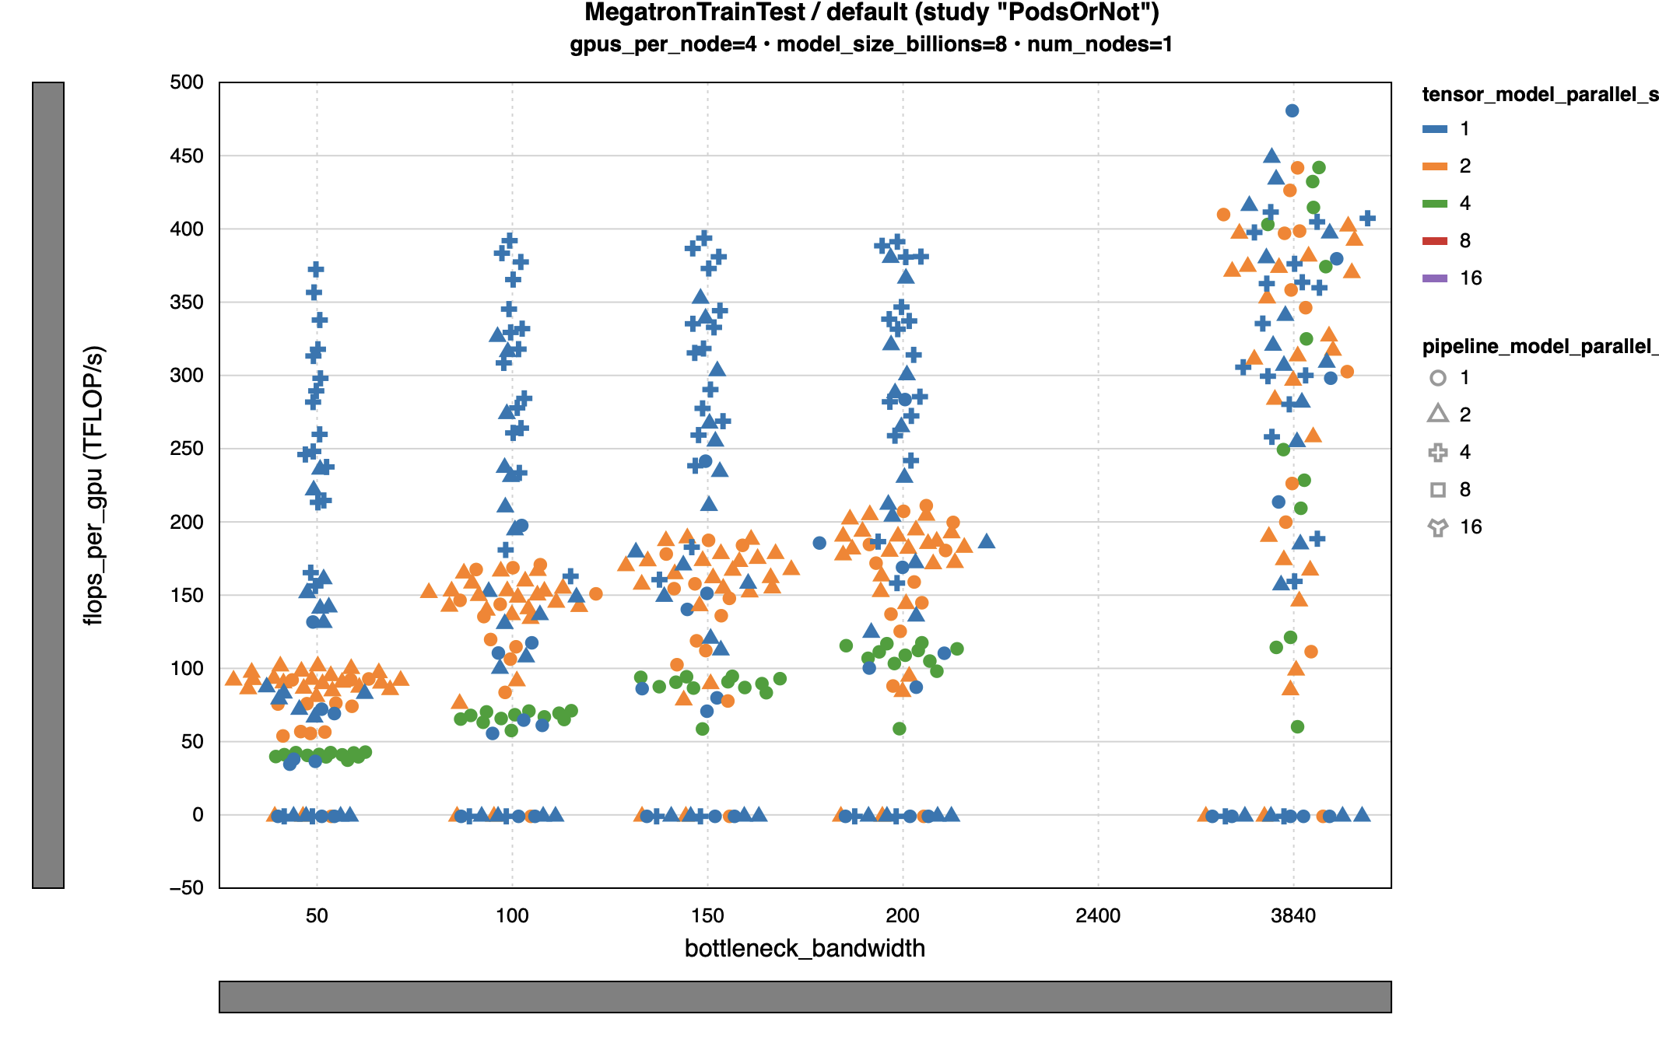
Using single node training we can show this scaling indeed continues

Slide 68
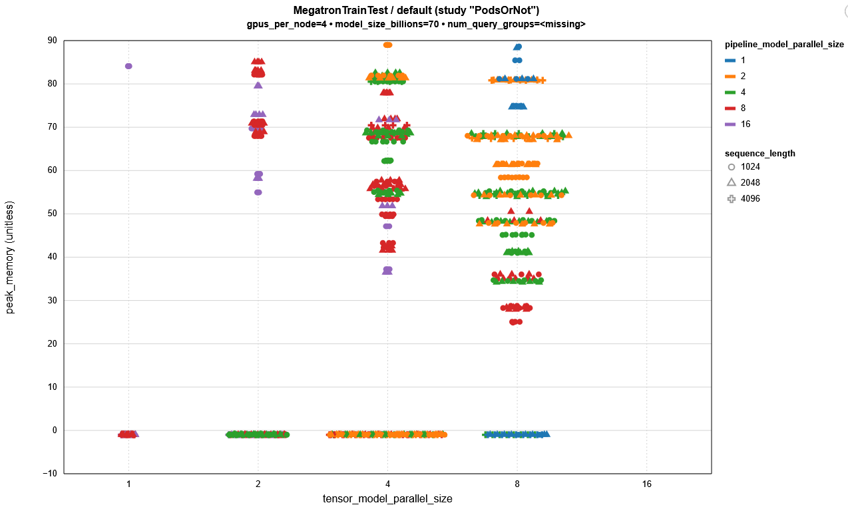
FLOPS efficiency scale with memory util
TP and PP decrease memory util enabling scaling in model size and input size
TP typically decreases memory consumption more than PP…

Slide 69
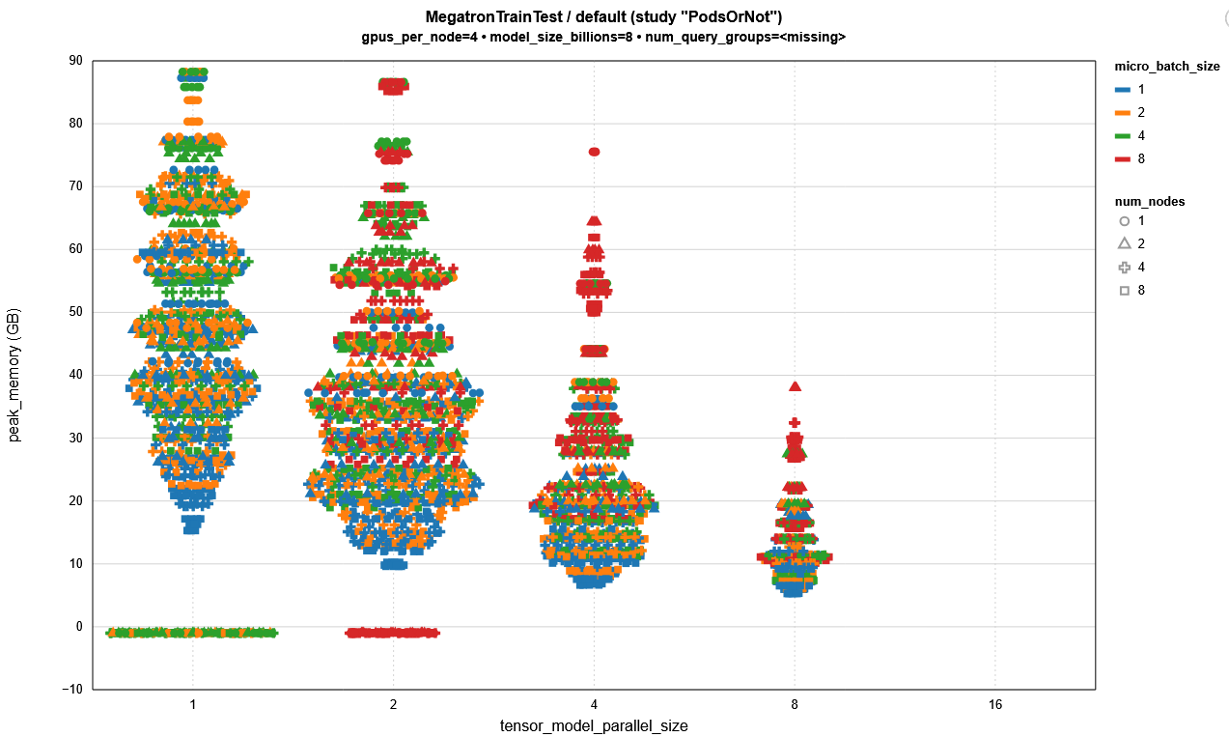






Underutilization
Of memory.
Performance of TP>=4 might have been even better with larger batch size/sequence length

Slide 70
What type of parallelism is applicable? Ease-of-implementation
Multiple (independent) training runs => Embarrassingly parallel
Single model takes too long too train => Data parallel
Single model is too big for memory => Model / Pipeline / Tensor / Sequence / FSDP
Single model is too big for memory and takes too long to train => Hybrid parallelism
All of the well-known, big models (GPT-X) are trained this way

Slide 71
What type of parallelism is applicable? Ease-of-implementation
Multiple (independent) training runs => Embarrassingly parallel
Single model takes too long too train => Data parallel
Single model is too big for memory => Model / Pipeline / Tensor / Sequence / FSDP
Single model is too big for memory and takes too long to train => Hybrid parallelism
All of the well-known, big models (GPT-X) are trained this way
Any cluster will do, no fast network needed

Slide 72
What type of parallelism is applicable? Ease-of-implementation
Multiple (independent) training runs => Embarrassingly parallel
Single model takes too long too train => Data parallel
Single model is too big for memory => Model / Pipeline / Tensor / Sequence / FSDP
Single model is too big for memory and takes too long to train => Hybrid parallelism
All of the well-known, big models (GPT-X) are trained this way
HPC cluster needed, i.e. with fast network and fast connections between e.g. GPUs in a single node

Slide 73
So….. What type of parallelization? Optimal performance
Data parallel (DP)
Easy to set-up.
Relatively infrequent and low-bandwidth communication (only once per forward/backwards)
Model is copied to each device, so redundancy in memory that might hamper efficiency
FSDP (fully sharded DP) partially solves this by sharding the model and retrieving the weights for a layer just-in-time. Requires more communication.
Pipeline parallel
Complicated to set-up, lots of tuning to avoid bubbles
Moderate communication (after each block of layers)
Significant memory reduction by splitting model and batches over devices
Tensor parallel
More involved than DP to set-up but does not suffer from bubbles. Computationally very efficient.
Very high bandwidth requirement
Significant memory reduction. Typically even more than pipeline

Slide 74
Do I need to parallelise?
Consider alternatives:
Model pruning
Use different hardware architecture
Reduced precision datatypes
Low rank fine-tuning (LoRA/QLoRA)
Quantization (inference)

Slide 75
Parallelization tools/wrappers
torch.distributed: https://pytorch.org/docs/stable/distributed.html
tf.distribute: https://www.tensorflow.org/guide/distributed_training
Data parallel:
PyTorch Distributed Data Parallel (DDP)
Model parallel:
DeepSpeed ZeRO
Torch FullyShardedDataParallel (FSDP): https://pytorch.org/docs/stable/fsdp.html
Wrapper of ZeRO-3
Huggingface’s accelerate: https://huggingface.co/docs/transformers/main/en/accelerate
ZeRO-1: Partition optimizer state
ZeRO-2: Partition gradients
ZeRO-3: Partition Model Weights

Slide 76
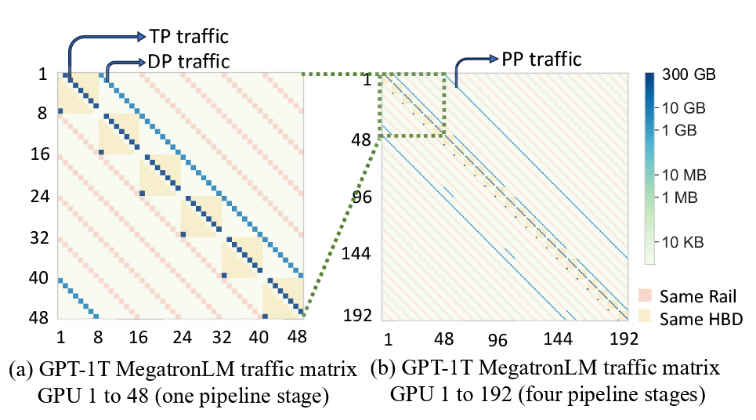
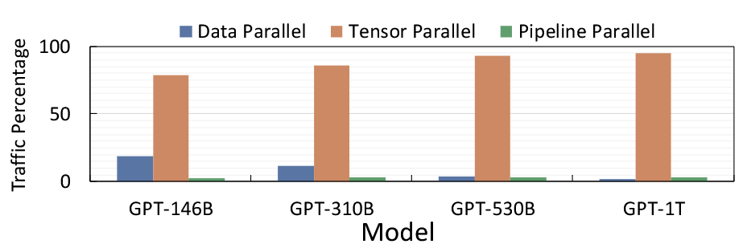
Fit your distribution method to your system
TP inside a node, PP/DP outside of a node

Slide 77
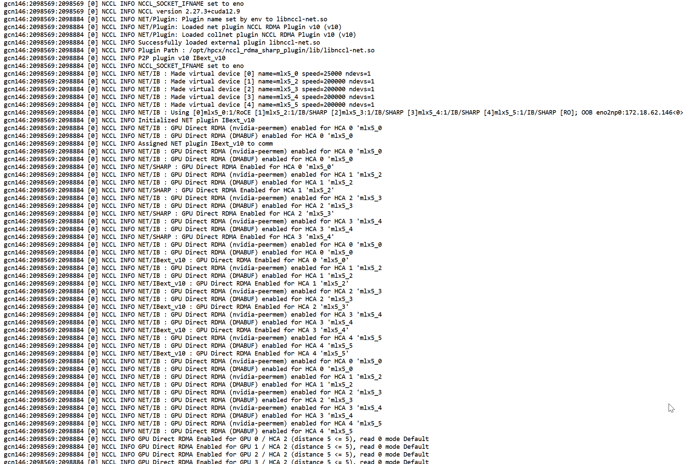
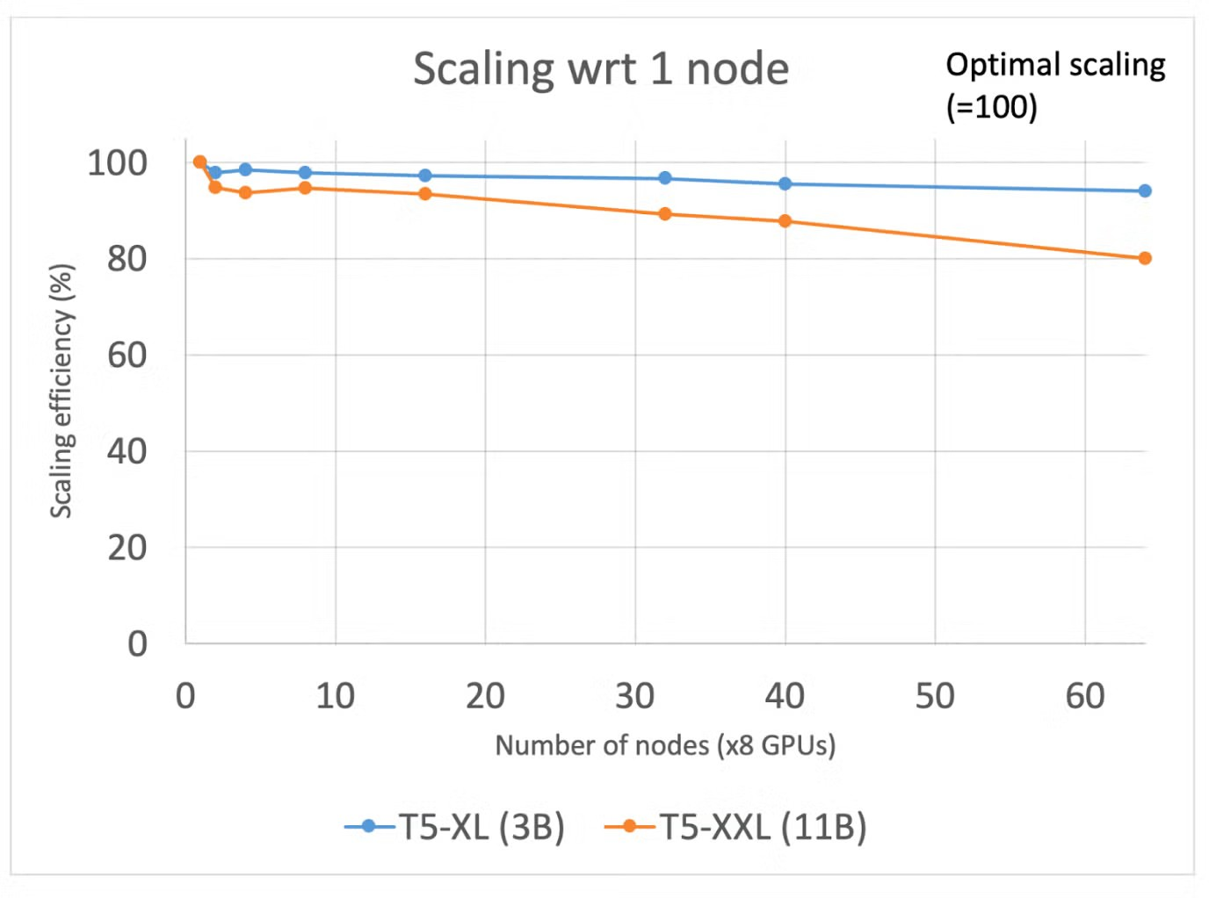
So you want to do multi-gpu?
Scaling inside a node is much easier than outside a node
Scaling should always be 90%+ (unless you have a very good reason not to)

Slide 78
Chapter orange
Monitoring!

Slide 79
Monitoring pyramid
Kernel-level profiling
Nsight compute
Job-level Profiling
PyTorch profiler, nsight systems
Time investment
Performance metric collection
Wandb, Tensorboard perf metric logging (e.g. iterations per second, %watts over time)
Runtime monitoring
Htop, nvtop, nvidia-smi, dcgmi

Slide 80
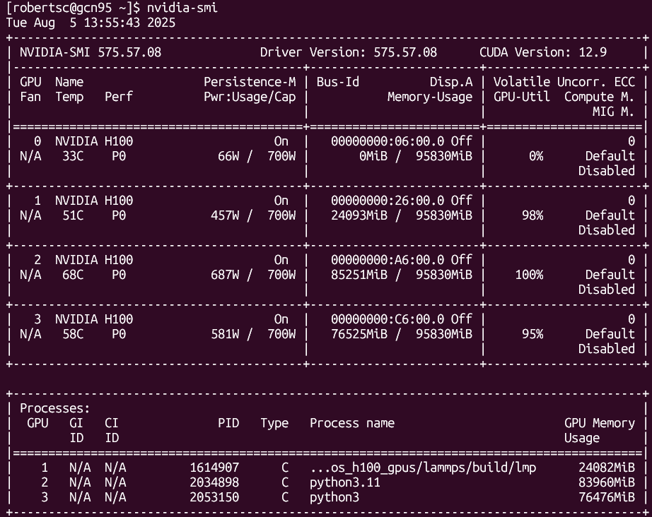
nvidia-smi

Slide 81
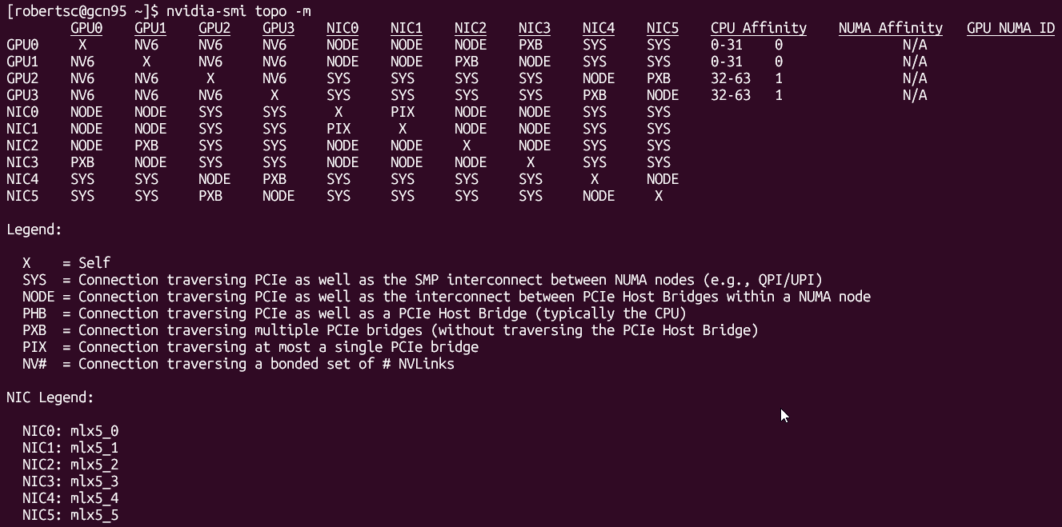
nvidia-smi

Slide 82
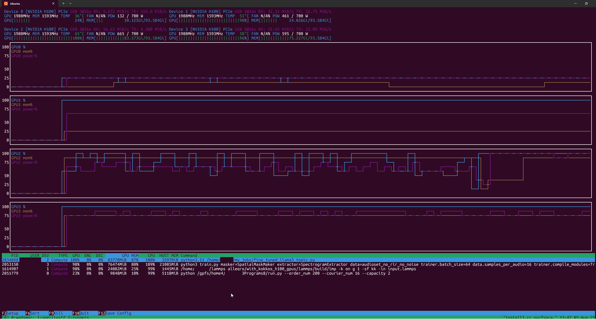
nvtop

Slide 83
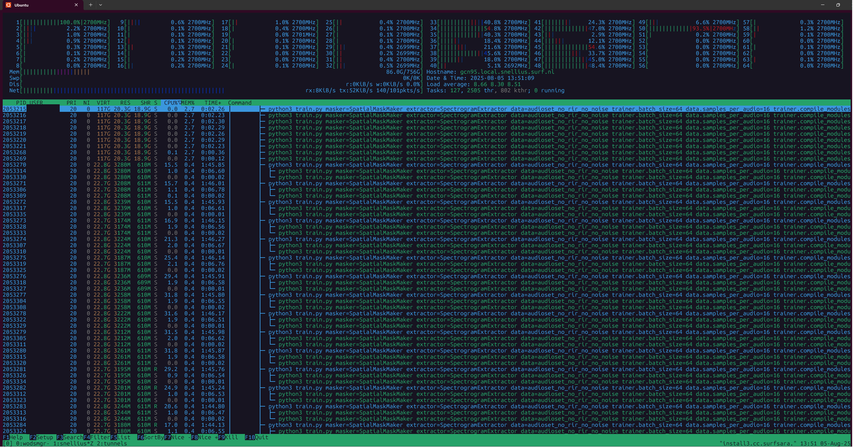
htop

Slide 84
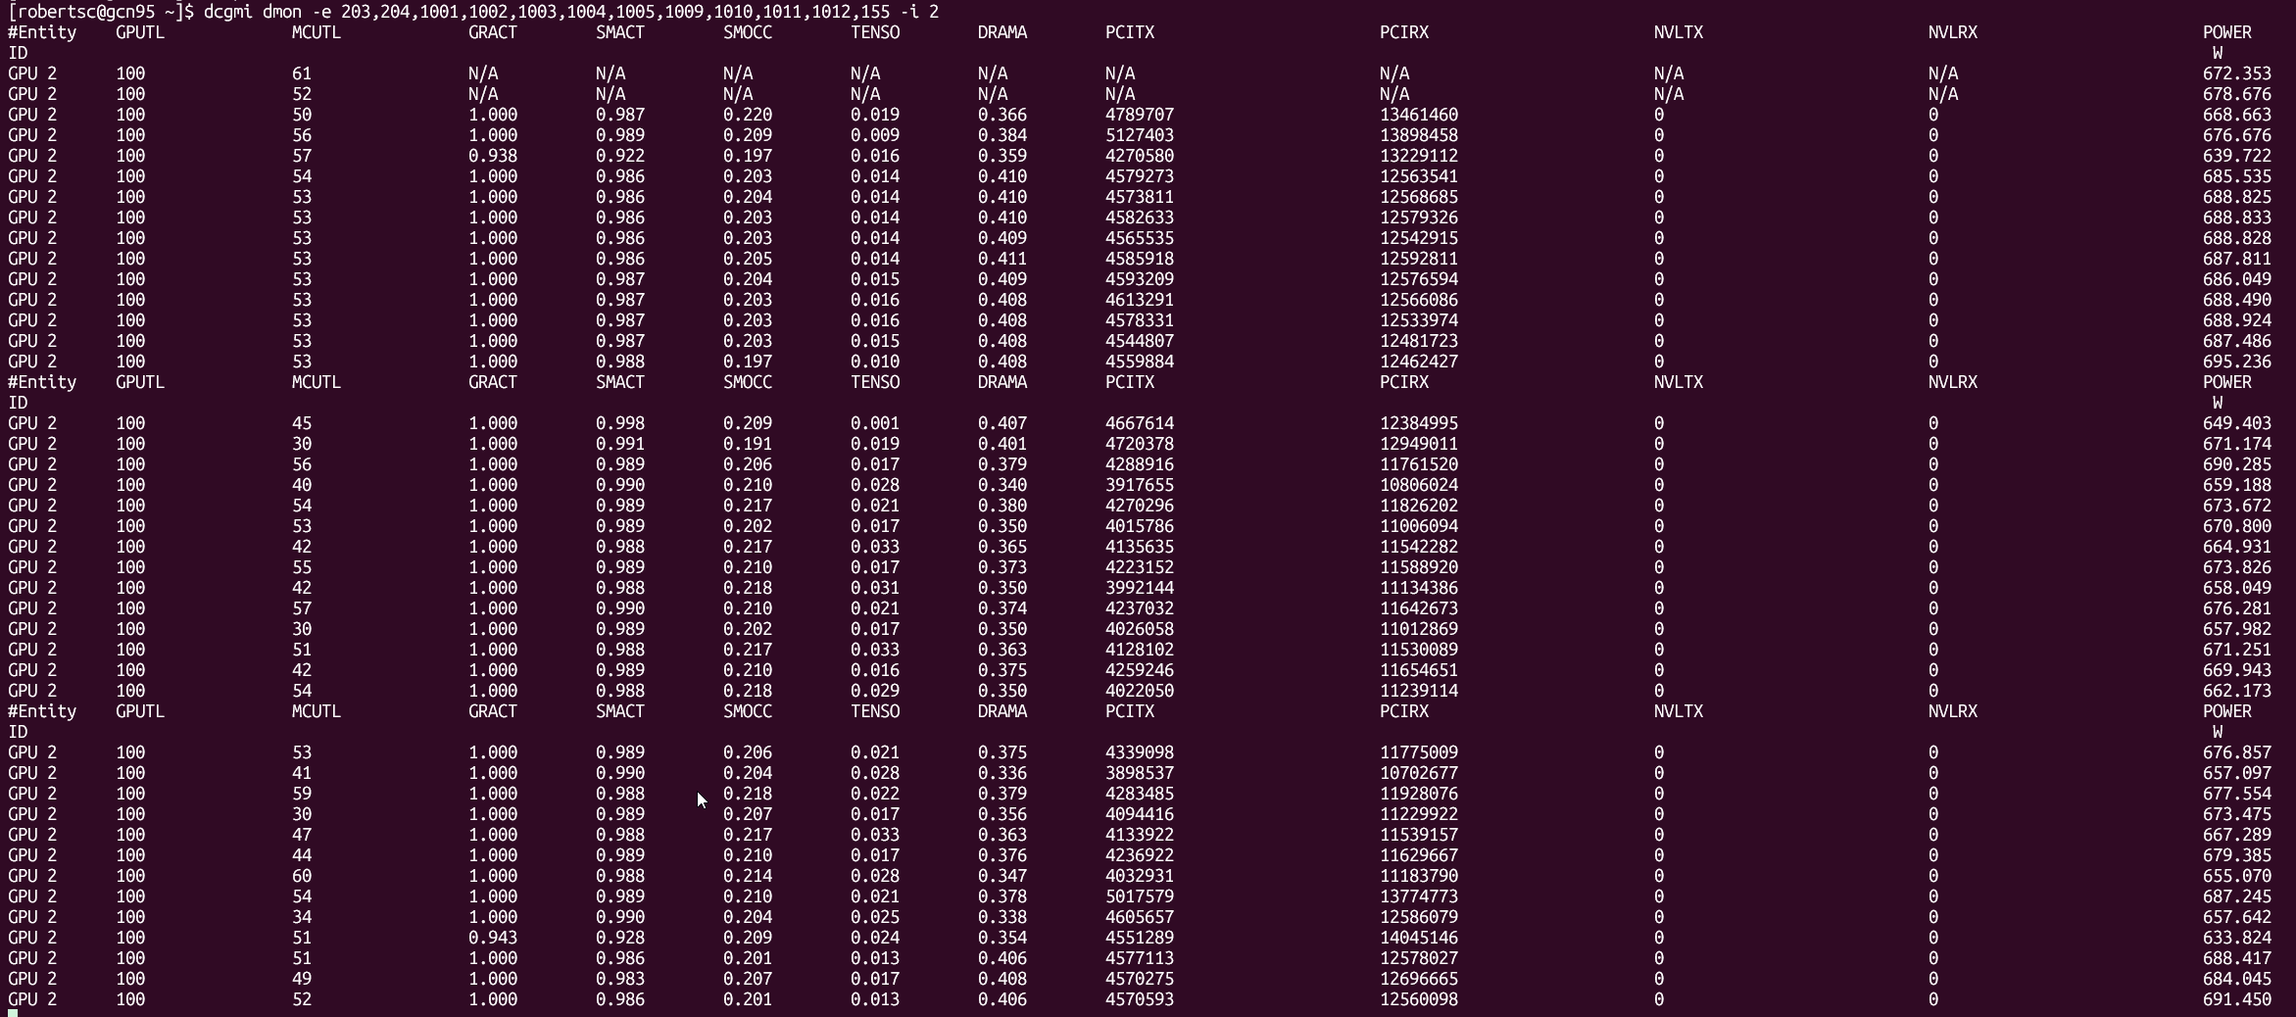
dcgmi

Slide 85
Chapter orange
Profiling…will be later

Slide 86
Chapter orange
Continuing with the S’

Slide 87


Second S: Software
PyTorch/TensorFlow vs Numpy
PyTorch and TensorFlow have GPU support, Numpy does not
Support for CUDA (Nvidia), ROCm (AMD), <insert exotic hardware here>?
E.g.: Intel SapphireRapids
IPEX: https://github.com/intel/intel-extension-for-pytorch
LUMI https://www.lumi-supercomputer.eu/
GDRDMA / SHARP / cuDNN / etc / etc / etc Not withstanding all the sys level dependencies
Support for lower precision
BFloat16, Float16? FP8? FP4?

Slide 88
Third S: Stack
Is my software compiled for my hardware
Pip install … ?
Module load PyTorch/2.1.2-foss-2023a-CUDA-12.1.1
Use containers!
https://catalog.ngc.nvidia.com/orgs/nvidia/containers/pytorch <- nvidia
https://hub.docker.com/r/rocm/pytorch <-amd
Again: Consider the hardware/platform that you’re using
GPU: Nvidia/CUDA? AMD/ROCm?
CPUs: AVX512?
Cerebras / Gaudi3 / etc. / etc.

Slide 89

System + Software + Stack Wait ... so what happens in torch?
You call torch
E.g. scatter_add_ -> Message passing in Graph-NNs
(Manual) Dispatching
Torch (python) determines the most appropriate function to call
Dispatching
Torch (C++/CU) calls the CPU/GPU kernel
Dispatching
Low-level C++/CU library performs actual calculation
Dispatching
PyTorch Dispatcher:
http://blog.ezyang.com/2020/09/lets-talk-about-the-pytorch-dispatcher/

Slide 90
In practice: PyTorch + Snellius
We only have NVIDIA GPUs
72x4=288 NVIDIA A100
88x4=352 NVIDIA H100
Makes optimization a bit easier for you
You only need to spend a year sifting through documentation
https://servicedesk.surf.nl/wiki/display/WIKI/Deep+Learning+on+A100+GPUs
Or ask us... :)
Every EINF/NWO small grants has a default of 4 consultancy hours

Slide 91


Rapidfire: implementation details
How fast do you want to go?
What is your goal?
Largest model possible?
Best validation performance?
Submit a paper to ISC ‘25?

Slide 92
Rapidfire: implementation details
Some useful resources:
https://pytorch.org/docs/stable/notes/cuda.html
https://docs.nvidia.com/deeplearning/performance/dl-performance-memory-limited/index.html
https://docs.nvidia.com/deeplearning/performance/index.html
Duncan: "You can take any piece of code, spend 6 months optimizing it, and then write a paper about it"

Slide 93
Level 0: "oh my god": torch.amp
If pytorch mixed precision isn’t working, probably you are doing something wrong
Gives you a free 2x+ speed boost
FP16 is probably better, BF16 is easier
FP8 is coming

Slide 94




Level 0: "oh my god": torch.compile
1 CPU core is pinned to 1 GPU (used to be worse)
CPU cannot keep up with the giant that is the GPU
Still (somewhat) need to know the magic incantation:

Slide 95

Level 1: Shouldn't impact model convergence:
Make sure every single layer/input/operation is done on multiples of 2, and probably preferable multiples of 8

Slide 96

Level 1: Shouldn't impact model convergence:
Make sure every single layer/input/operation is done on multiples of 2, and probably preferable multiples of 8

Slide 97




Level 1: Shouldn't impact model convergence:
Avoid CPU-GPU sync
Create tensors directly on the device
✅

Slide 98

Level 1: Shouldn't impact model convergence:
Avoid doing these inside a training loop if possible:
This forces PyTorch to copy data from GPU to CPU, slowing performance.

Slide 99

Level 1: Shouldn't impact model convergence:
Don't aggregate tensors which still require grad, e.g.: losses.append(loss) (:o)
instead, detach (loss.detach())
Each loss in losses.append(loss) stores the entire computation graph. PyTorch stores extra gradients unnecessarily!
detach() creates a new tensor with the same values but removes the gradient tracking.

Slide 100


Level 1: Shouldn't impact model convergence:
There is little reason not to use TensorFloat32 ☺
torch.backends.cuda.matmul.allow_tf32 = True
The default in PyTorch (silently)
torch.set_float32_matmul_precision('high')
torch.backends.cudnn.benchmark = True
Empirically benchmarks to find fastest method
Align bytes: multiples of 2, 8, 1024
DNN libraries want nicely aligned memory
torch.channels_last
Helps with memory alignment and reduces cache misses
Compile: PyTorch 2.0
Big speedup, but sensitive to implementation
Helps maintain accuracy in cases where TF32 might introduce minor errors
Stores images in NHWC format instead of NCHW (optimizes GPU cache usage)

Slide 101

Level 2: Danger zone
Lower precision (FP16 or BF16) for matrix reductions instead of higher precision (FP32, advised). Can cause numerical instability!
torch.backends.cuda.matmul.allow_fp16_reduced_precision_reduction = True
Lol:
torch.backends.cuda.matmul.allow_bf16_reduced_precision_reduction = True
Torch.set_float32_matmul_precision('medium')
Cast model and data to (B)Float16 before the forward pass
We're not supposed to...but:
trades some accuracy for faster compute. Can affect model convergence
Forces all computations to use lower precision, instead of letting autocast() to choose

Slide 102


Or: Change your model
Worst case scenario:

Slide 103

Or: Change your model
Change model architecture to improve performance characteristics, e.g.:
Use LoRA for fine-tuning
Use pre-trained model aka zero shot (@train VAE for latent space creation or use pre-trained model)
E.g. Llama, DINOv2
Incorporate dataloading operations into the model instead of CPU pipeline
ViT vs CNN vs GNN
Change non-linearities
Multiples of 2,8,1024
Channels
Hidden size
Vocab size
Batch size
Input resolution/sequence length
Everything
For transformers:
Patching
Masked attention

Slide 104

Always
Have a baseline
Check convergence statistics

Slide 105

Profile
Get a grip on your model’s performance
Profile
Profile
Profile

Slide 106
Chapter orange
On that note: Profiling!

Slide 107
Profile
Notebook available at https://github.com/SURF-ML/HPML-course-materials/blob/august2025/Day2/notebooks/PyTorch_profiling.ipynb
Reference traces are in https://github.com/SURF-ML/HPML-course-materials/tree/august2025/Day2/notebooks/logs
``` python3 -m venv venv source venv/bin/activate pip install git+https://github.com/pytorch/kineto.git#subdirectory=tb_plugin git clone --depth=1 https://github.com/SURF-ML/HPML-course-materials.git tensorboard --logdir HPML-course-materials/Day2/notebooks/logs/ ```

Slide 108
Chapter orange
Bonus: AI Factory

Slide 109

AI factories recap
Initiative by the EU to close the AI-gap to our ‘friends’ to the west and to our ‘friends’ to the east
Bootstrapping AI development and AI uptake in Europe
Budget ‘fluid’; up to EC discretion So far ~€1.5 billion granted Up to €200 million matched per site
AI Gigafactories also announced: ~€20 billion available
‘Create AI aligned with EU values’
We want to build an AI factory, ready end of 2026 in The Netherlands

Slide 110
AI factories recap
We want to build an AI factory, ready end of 2026 in The Netherlands
Seems Lithuania and the Netherlands are competing in the same round ☺ https://www.madeinvilnius.lt/en/business/Vilnius-market/The-ambition-is-to-have-one-of-the-most-powerful-di-centers-in-Europe-in-Lithuania./

Slide 111


AI factories setup
Technically:
“AI factory” -> expertise center
“AI facility” -> supercomputer
“AI factory” sometimes means both
Dutch AIF:
200M euro total budget
1/3rd of the budget towards facility
Operational Q4 2026

Slide 112
Do we even need an AI factory?
You tell me ☺
Current (national) hardware is not sufficient for current & next-gen workloads
National perspective:
Data sovereignty & country borders are important (UMC’s)
Foster national ecosystem

Slide 113


Do we even need an AI factory?
Our perspective:
On average, the HPML teams gets 3-4 tickets per day regarding AI
Application support and compute resource requests, on average taking 1-4hrs (one person fulltime)
AI says we practically get infinite tickets a day at the end of 2026 (Actually ~15, extrapolated, 5 people fulltime)
Not withstanding larger application support
Industry perspective:
AI has firmly taken over the HPC world
“AI is the new HPC” -> AMD: “in 2025 ~30M datacenter GPUs datacenter were sold, of which ~500k for HPC applications”
Public perspective:
Data and compute sovereignity is of paramount importance
AI factories and Gigafactories

Slide 114

Who to design the AI factory for?
50/50 split between EuroHPC JU and The Netherlands
EuroHPC jobs almost per definition are large applications
Dutch Research?
Primarily ‘just’ need many GPUs, less emphasis on large jobs
SME?
Data security very important
More inference / always online type jobs
Public?
Again, data security
Small jobs?

Slide 115


Who to design the AI factory for?
Again, what to optimize for?
Do we want/need 10 vans or 1 Ferrari?
Critical scale for certain training runs (‘small’ Large-LMs)
Probably in the order of ~2k GPUs IFF tightly coupled (https://arxiv.org/pdf/2412.19437)
Source: https://arxiv.org/html/2410.21680v1

Slide 116


Critical innovations for AI
Matmuls are unreasonably efficient
Reduced precision (FP64 is dead)
double whammy of increased FLOPS and reduced memory footprint (many workloads are membw bound)
High-bandwidth domains:
order-of-magnitude faster interconnect than current interconnect
Enables model sharding (FSDP, Tensor-Parallel, MoE) Bigger models are simply better (given enough data)
Pods

Slide 117
So where does that leave us?
Disclaimer time:
None of this is final
Good ideas are always appreciated
Fully dependent on funding
HW design TL;DR: (Goes without saying) optimize both for capability and cost-effectiveness
Exascale 16-bit TFLOPS
Power envelope: 5MW
Compute: as many big AI GPUs as possible
Storage: tiered
Network: optimized

Slide 118


Compute
Performance partition: 1k GPUs
Big GPUs, Big interconnect PFLOPS per GPU, 200GB+ HBM VRAM
Focus on training or big-model inference
120-240kW+ per rack
Efficient partition
Cost effective GPUs
No interconnect
Online inference
CPU partition
Pre/Post processing and CPU-based ML
Specialized partition
Exotic hardware for specific use cases

Slide 119
Storage
Tiered:
‘Hot’ storage: all-NVMe SSD scratch
ML workloads are very often continuous-load high-IOps
No node-local storage! (?)
‘Warm’ storage: performant spinning disk parallel fs
Backbone of the system
‘Lukewarm’ storage: object store
Data ingress, and integration with cloud and other EU systems
‘Cold’ storage: tape
Not generally available to users, but used as cost-effective backend for data storage and archival purposes

Slide 120
Interconnect
Probably 4-8 GPU’s per node all-to-all
Memory is large enough to not need Pods
Big ‘scale-out’ network is probably not necessary
We are too small for that
E.g.: two supplementary 800Gbps NICs per node for dataloading or scale-out

Slide 121



Interconnect
All-copper ‘scale-up’
8Tbps+ per GPU BW, connected directly to the GPU
For reference: Snellius GPU nodes = 2x200Gpbs divided over 4 GPUs
Single layer of switches connect up-to 256 GPUs
Big ‘scale-out’ network is probably not necessary
We are too small for that
E.g.: single supplementary 800Gbps NIC per node for dataloading or scale-out

